Slide 1
14
ED Simulator Based Training – Scenario Guide
Set |  | Scenario (Start) |  | Scenario (Progression) |  | Equipment
Adult |  | 21 yr old female self presented to A&E with 6 hour history of abdominal pain and vomiting. She had 2 loose stools. Assessment bay obs revealed EWS of 5.She has been moved to resus with ? Sepsis No history of PV bleed. LMP 2 weeks ago. Not on OCP but denies sexual contact. PMH None DHx None SHx Paediatric Nurse. |  | Patient will continue to detiorate. Will have to be taken to theatre from A&E. |  | -Sim-Man (complete kit) -Lifepak defib with training leads -Training ‘resus’ equipment trolley -Resus Cannulation trolley
ED Resus Room
Time: (45 mins) Simulation: 20 Debrief: 10 Recover: 5
 |  |  |  |  |  | Supporting Documents
 |  |  |  |  |  | Nursing assessment sheet Obs chart, ED chart, Drug Chart VBG,FBC,INR,ECG,Urine PT PV bleed performa
Main objectives (Clinical and Educational Context): To demonstrate effective, structured A-E primary assessment and to make a clinical diagnosis of Ectopic Pregnancy Arranges urgent Gynaecology referral Recognises hemodynamic instability & initiates blood transfusion
Simulator start state | Position Supine on ED trolley in resus bay |  | Observations A – Clear & self maintaining. B - Rate 26, SpO2 98%. C - Pulse 110, BP 89/60. D – GCS 15 pupils equal reactive E – Tpr 36.9 |  | Clinical Findings Tender abdomen.Localised guarding left iliac fossa.Bowel sounds present
Expected course: Primary survey Identifies Ectopic Preg Resuscitate Gynae referral Blood transfusion

Slide 2
14

Slide 3
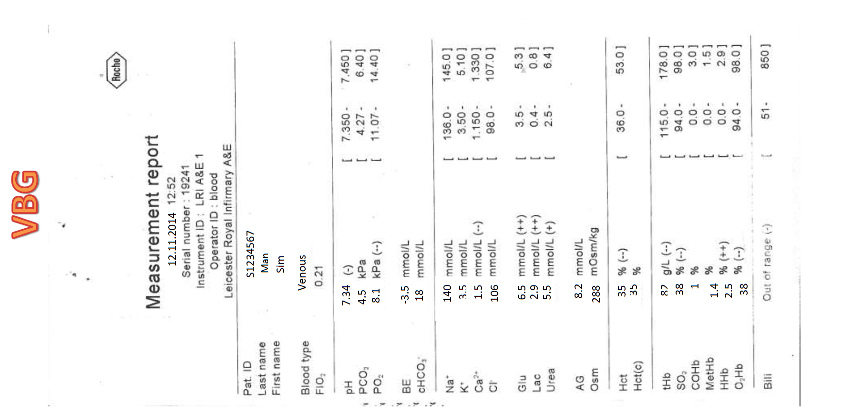
14
ED Simulator Based Training – Scenario Guide 1

Slide 4
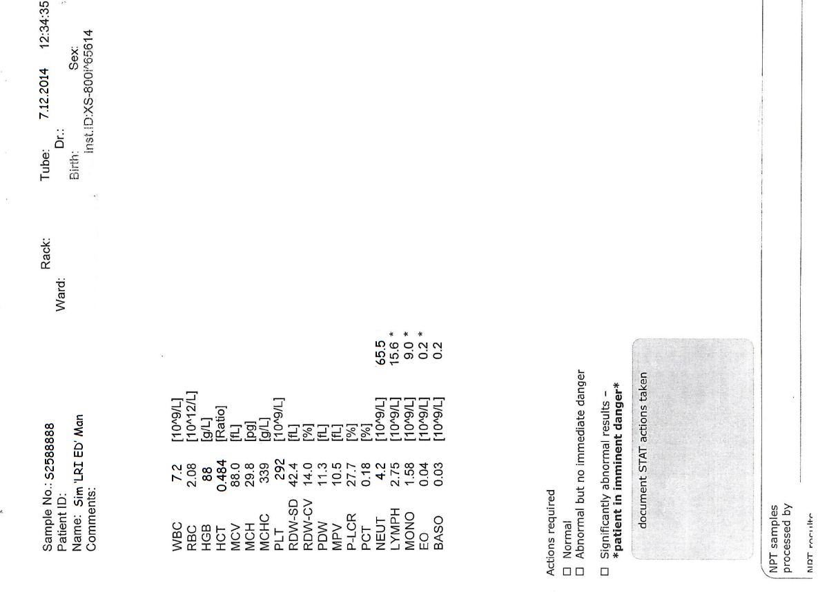
14

