Slide 6
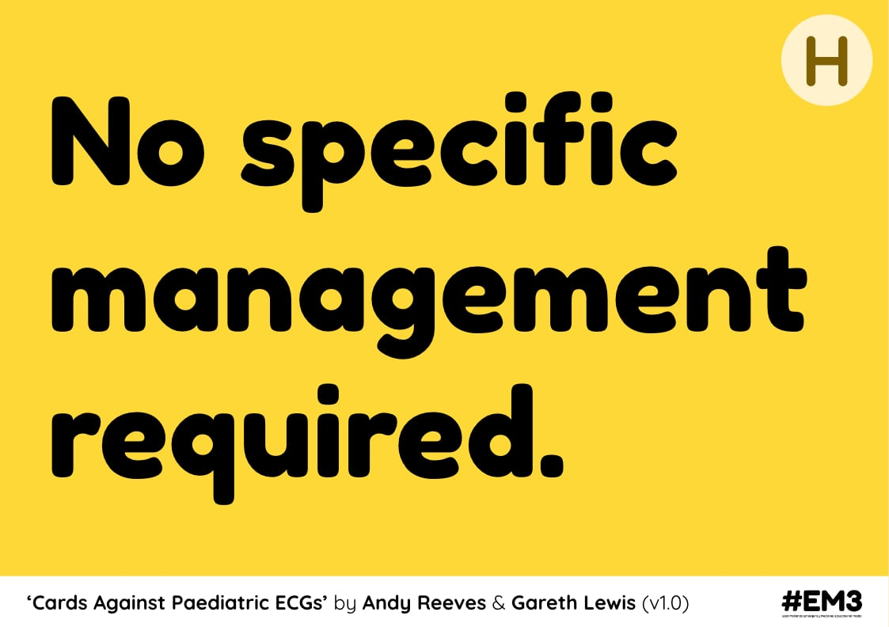

Slide 8
Notes:
https://radiopaedia.org/cases/olecranon-fracture-8

Slide 16
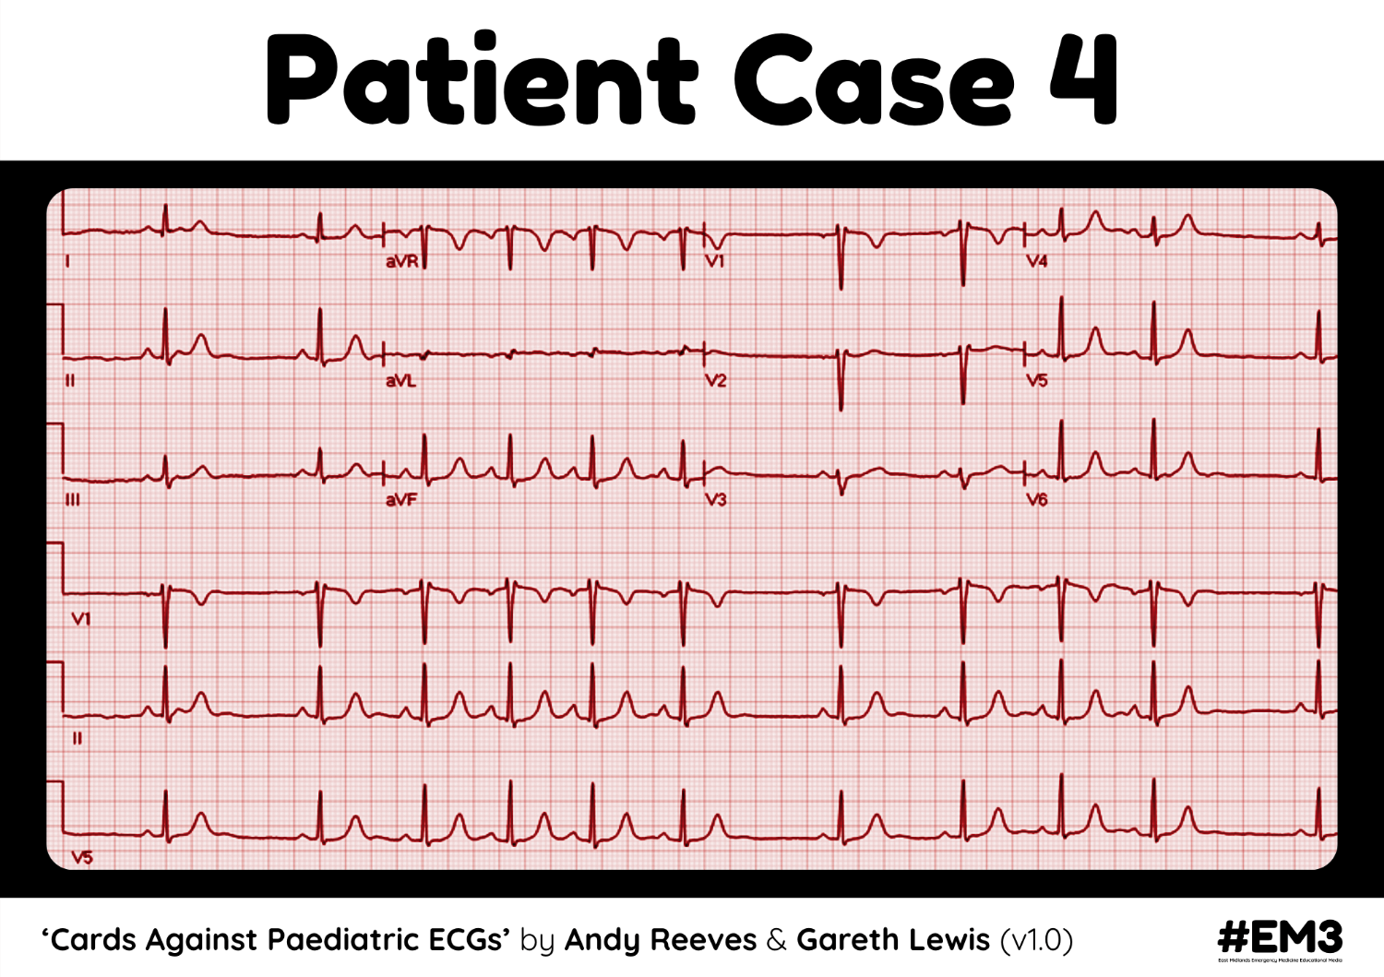

Slide 20
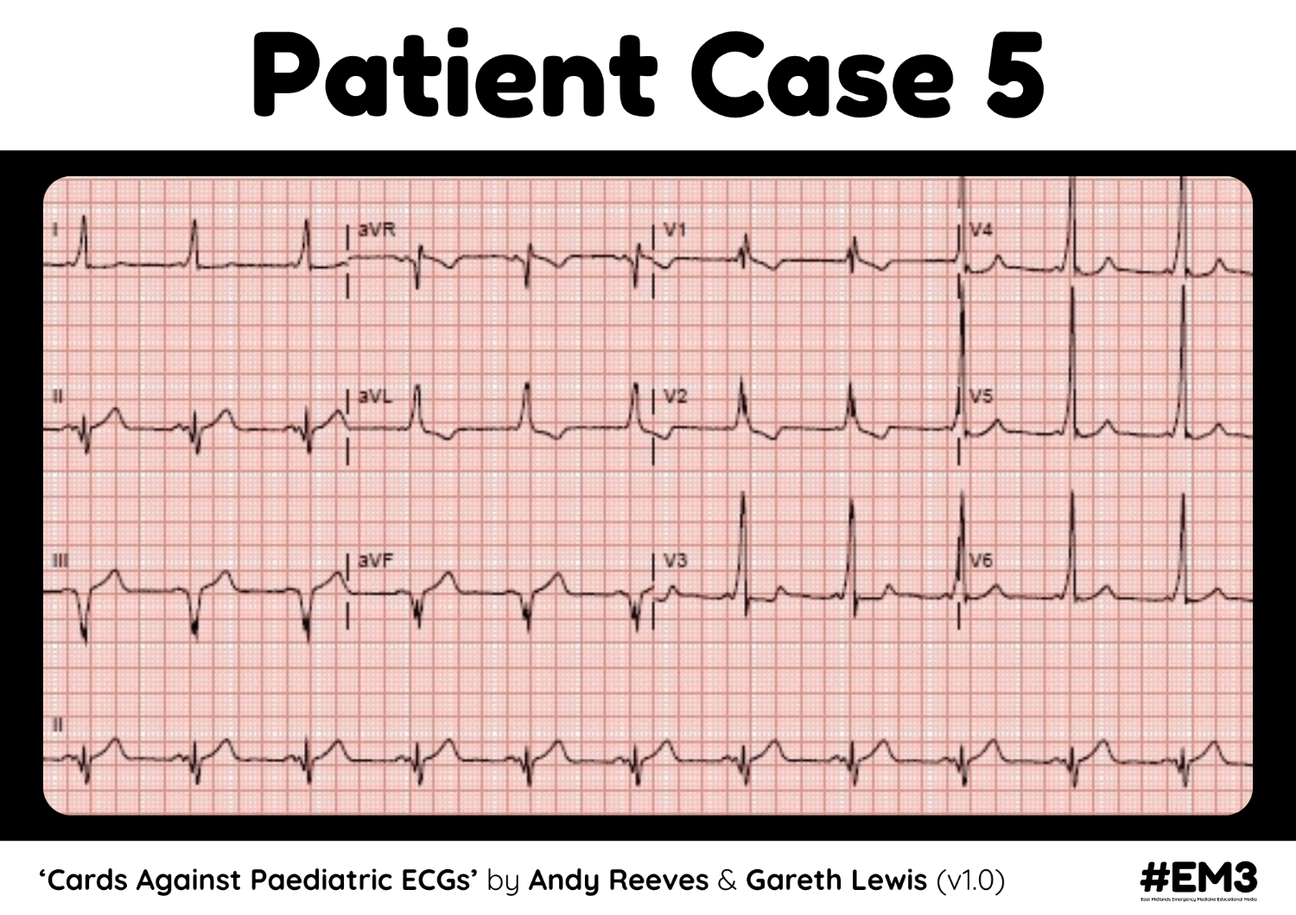

Slide 24
Notes:
Long QT ECG

Slide 40
Notes:
https://www.semanticscholar.org/paper/Tricuspid-Atresia-in-the-Neonate-Rao-Alapati/7247b335bc6fbcf7981e457a01f50780f820f3a9#citing-papers

