Slide 1
ED Simulator Based Training – Scenario Guide
Set |  | Scenario (Start) |  | Scenario (Progression) |  | Equipment
Adult |  | 61 yr old male is brought to Resus by paramedics with the history of hematemesis that started few hours ago. During transfer to hospital, pt had further 2 large episodes of hematemesis. He is a chronic alcoholic and had variceal bleed followed by banding 2 years ago.He denies maelena. PMH Alcoholism, CLD DHx Spironolactone, propanolol, thamine, chlordiazepoxide SHx Married 2 kids drinks alcohol +++, non-smoker |  | Starts treatment of GI bleed. Pt has further episodes of hematemesis and drops blood pressure further. With O-ve blood transfusion, pt condition stabilizes but requires urgent consultation with GI reg/consultant and ITU. Scenario ends when decision to take pt to endoscope is made |  | Sim-Man (complete kit) Lifepak defib with training leads Training ‘resus’ equipment trolley Paperwork ED sheet Nursing notes GI bleed performa Drug chart
ED Resus Room
Time: (45 mins) Simulation: 30 Debrief: 10 Recover: 5
Main objectives (Clinical and Educational Context): To demonstrate effective, structured A-E primary assessment and to make a clinical diagnosis of Massive GI bleed Effective and appropriate clinical management of AUGIB Follow AUGIB Performa Consultation with ACB Reg/GI Reg for transfer to Urgent endoscopy
Simulator start state | Position Semi-recumbent on ED trolley in resus bay |  | Physiology A – Clear & self maintaining. B - Rate 25, SpO2 98%. C - Pulse 130, BP 87/60. D – E4 V5 M6 pupils equal E – Tpr 36.9 |  | Clinical Findings Cold, sweaty and pale Fresh blood visible around mouth and lips
Expected course: Primary survey Identification of Massive GI bleed Initiation of treatment(AUGIB performa) recognition of persistent hemodynamic compromise Transfuse O-ve Referral to GI reg/ITU

Slide 2
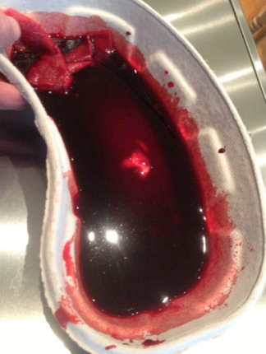

Slide 3
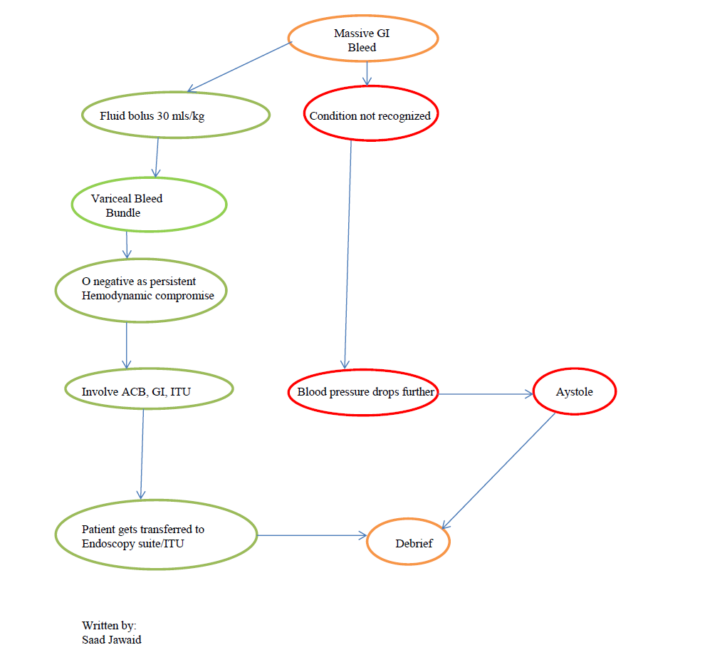
ED Simulator Based Training – Scenario Guide 1

Slide 4
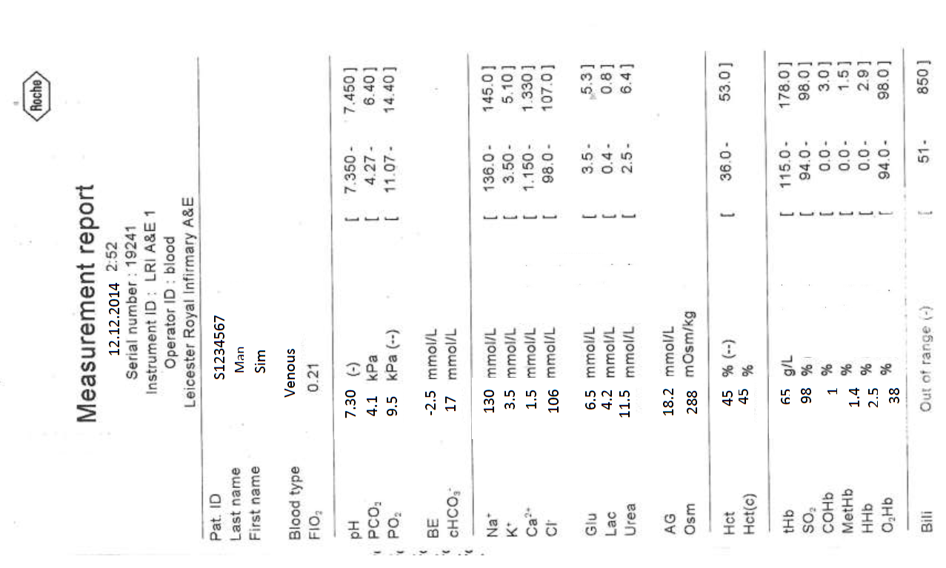

Slide 5
