Slide 1
ED Simulator Based Training – Scenario Guide
Set |  | Scenario (Start) |  | Scenario (Progression) |  | Equipment
Adult |  | 66yr old male is brought to Resus by paramedics with the history of cough and DIB for 2 days. He is k/c of COPD and has worsening of cough for last 1 day. His wife reports fever upto 38.8 C.He has been more confused since morning. PMH COPD,HTN DHx Lisinopril, Salbutamol , Beclometasone SHx Married, 2 kids Drinks alcohol on weekends, ex-smoker |  | Blood gas shows Type 2 respiratory failure.COPD initial care bundle is carried. After nebs,pt becomes more drowsy and GCS drops to 11 (E2V4M5). Repeat ABG shows worsening of acidosis and increase in CO2. Initiate NIV.Appropriate referral to ACB,Resp Reg,ITU |  | Sim-Man (complete kit) Lifepak defib with training leads NIV Training ‘resus’ equipment trolley
ED Resus Room
Time: (45 mins) Simulation: 30 Debrief: 10 Recover: 5
 |  |  |  |  |  | Required documents ED and nursing sheets Resp failure performa
Main objectives (Clinical and Educational Context): To demonstrate effective, structured A-E primary assessment and to make a clinical diagnosis of Hypercapnic Respiratory failure(type II) Effective and appropriate clinical management using Acute Hypercapnic Respiratory failure pathway Initiate NIV when ABG worsens Consultation with ACB Reg/Resp Reg for admission
Simulator start state | Position Semi-recumbent on ED trolley in resus bay |  | Physiology A – Clear & self maintaining. B - Rate 29, SpO2 98% 15L NRB. C - Pulse 130, BP 90/95. D – E4 V5 M6 pupils equal E – Tpr 38.1 |  | Clinical Findings B/L wheezes tachypnea
Expected course: Primary survey identification of Type II Resp failure Initiation of COPD bundle(Hypercapneac failure Performa) recognition of worsening Initiation of NIV Referral to Resp Reg

Slide 2
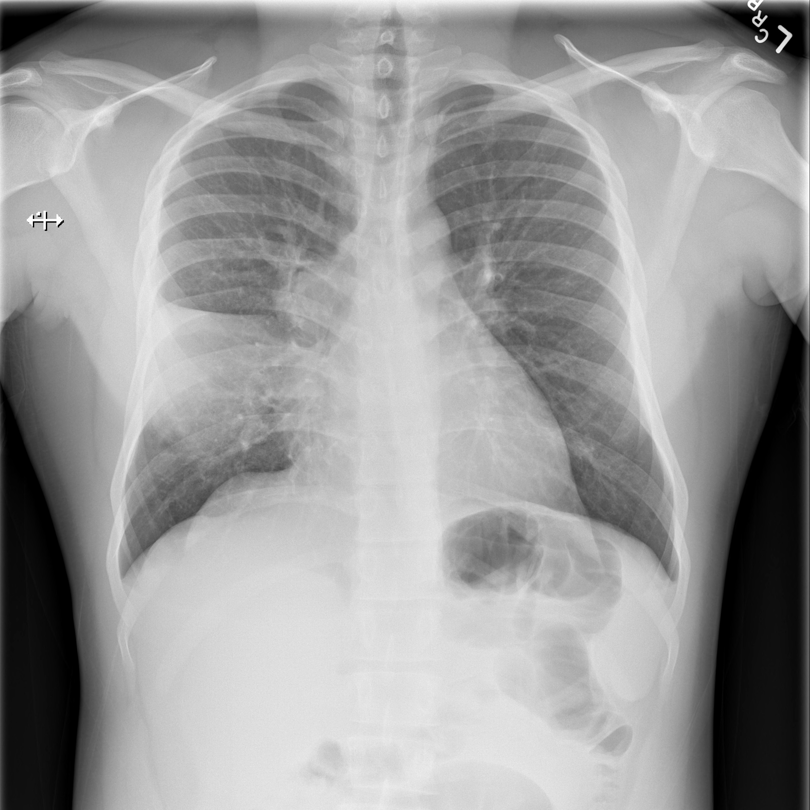

Slide 3
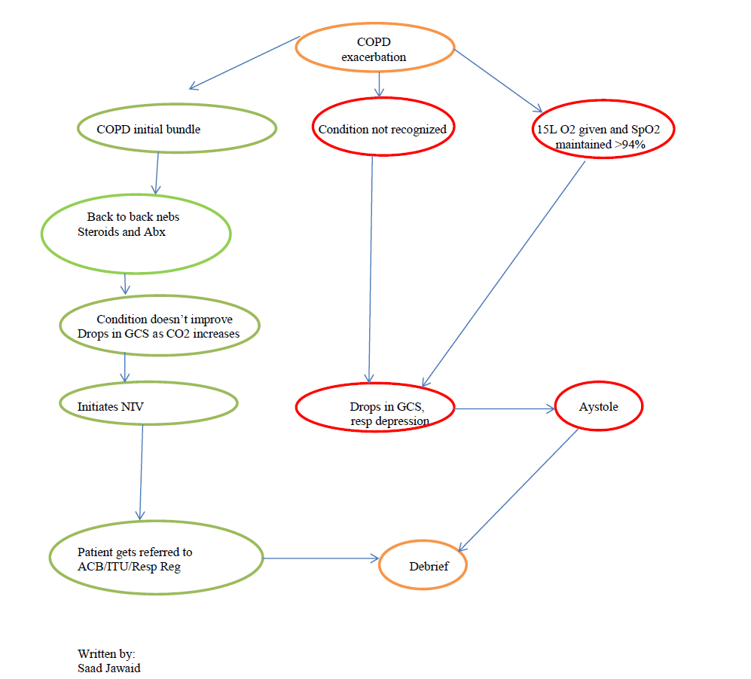
ED Simulator Based Training – Scenario Guide

Slide 4
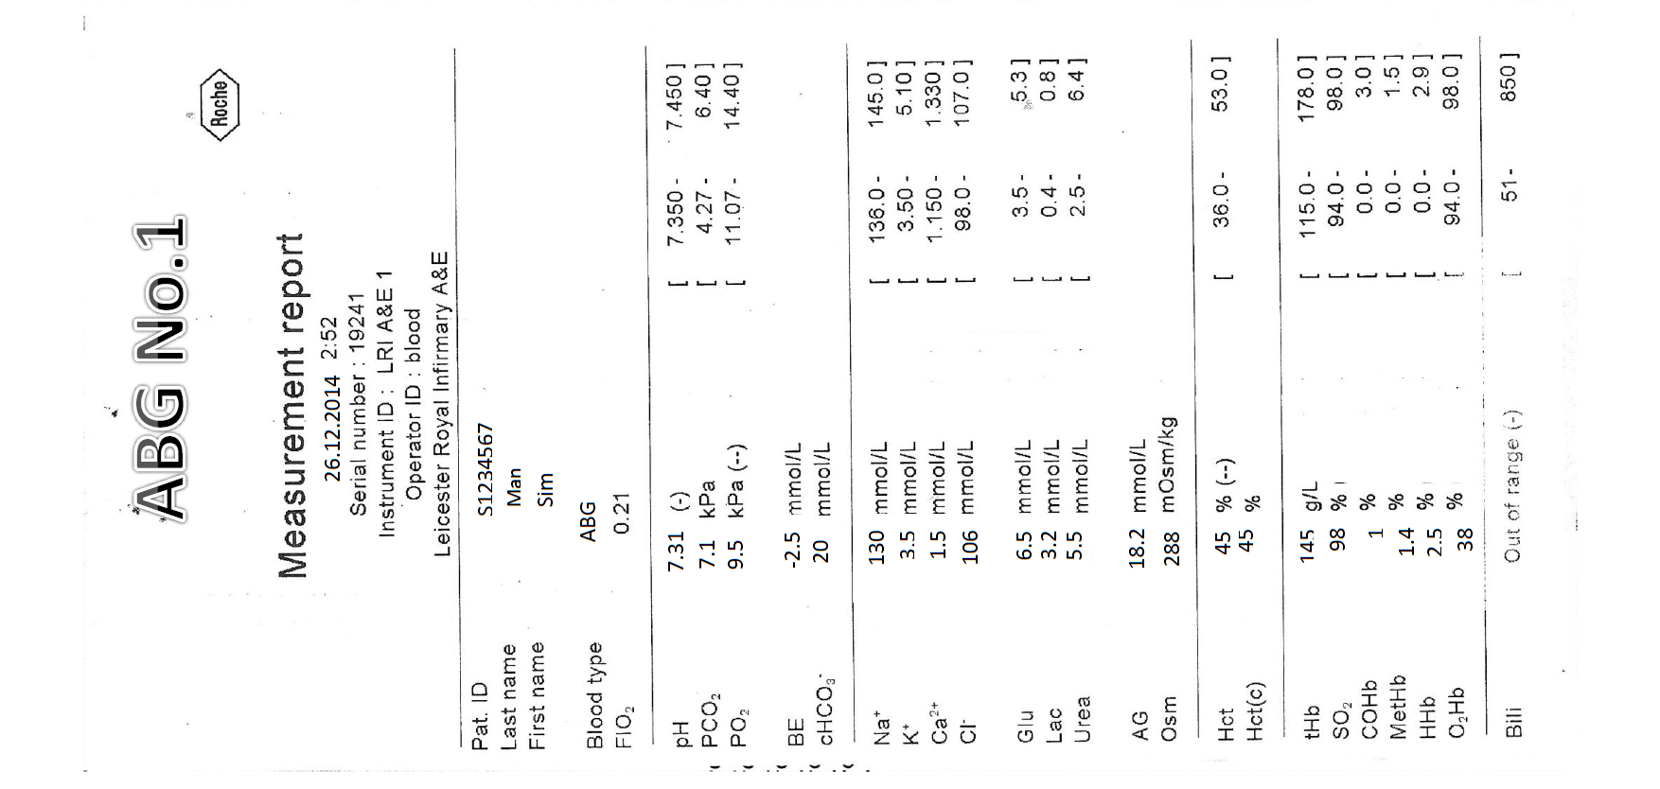

Slide 5
