Slide 1
ED Simulator Based Training – Scenario Guide
Set |  | Scenario (Start) |  | Scenario (Progression) |  | Equipment
Adult |  | 53 year old presented after an episode of collapse while he was trying to stand up from sofa. He had D&V for 2 days and has not been eating or drinking well .He has received 1.5L saline by paramedics.He also has had abdominal pain for 1 day. PMH Lymphoma- Chemo 8/7 ago Penicillin allergy |  | Shocked. Neutropenic sepsis. Decreased Hb and platelets. Patient does not look in extremis at end of bed Urine dip positive Changes on CXR- ? Related to previous effusion, ? Consolidation Little response to fluids May consider surgical review |  | Sim-Man (complete kit) Lifepak defib with training leads Training ‘resus’ equipment trolley
ED Resus Room
Time: (35 mins) Simulation: 15 Debrief: 15 Recover: 5
Main objectives (Clinical and Educational Context): To demonstrate effective, structured A-E primary assessment Recognise patient shocked, probable DIC and low potassium Initiate sepsis treatment Recognition not improving post initial treatment Refer to Haematology and ICU |  |  |  |  |  | Required documents
 |  |  |  |  |  | ED sheet Nursing sheet Obs chart
Simulator start state | Position Semi-recumbent on ED trolley in resus bay |  | Physiology A – Clear & self maintaining. B - Rate 22, SpO2 100% on O2. C - Pulse 110, BP 86/51. D – E4 V5 M6 pupils equal E – Tpr 38.2 |  | Clinical Findings Crepts at base of chest. Generalised tender abdomen
Expected course: Sepsis Rx started Abx for Neutropenic Sepsis No response to initial treatment Refer to oncology Involves ITU→ Consider Surgical review for abdominal sepsis
Adapted with permission from Magpas, the Emergency Medical Charity

Slide 2
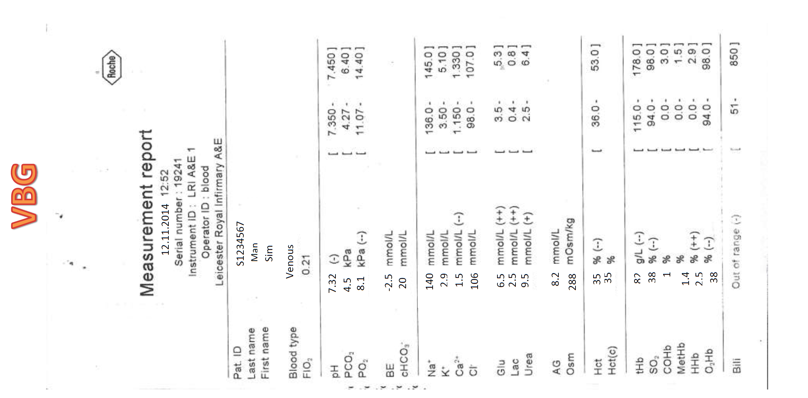

Slide 3
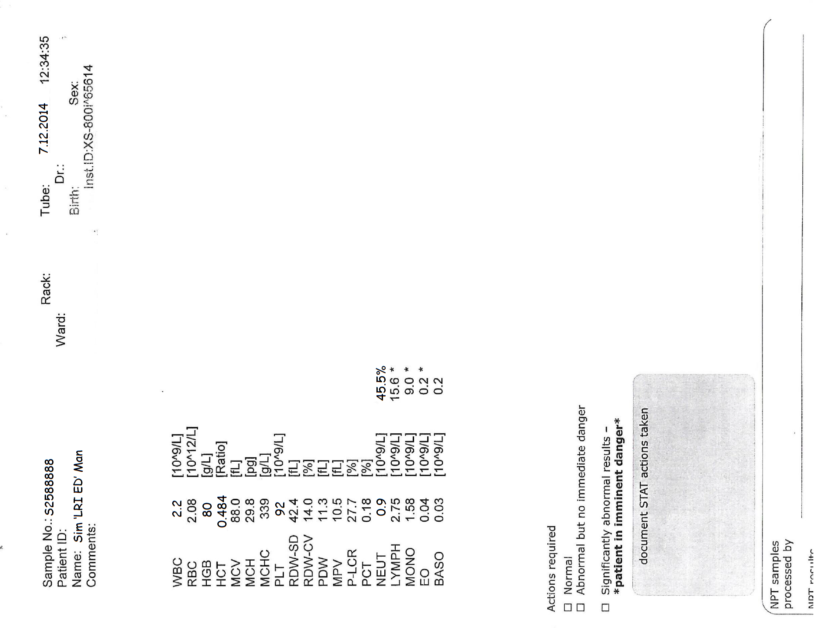

Slide 4
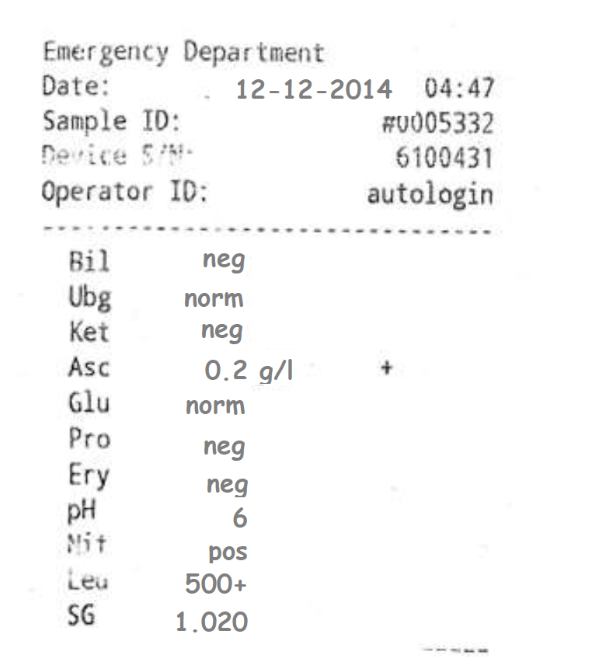

Slide 6
