Slide 1
ED Simulator Based Training – Scenario Guide
Set |  | Scenario (Start) |  | Scenario (Progression) |  | Equipment
Adult |  | 21yr old female k/c of type I DM is brought to Resus by paramedics with the history of vomiting for 1 day. She has been feeling unwell since yesterday and reported increase frequency of urine. PMH DM DHx Insulin Nova-rapid and Act-rapid SHx University student Occasionally drinks alcohol, non-smoker |  | Starts treatment of DKA according to protocol and gives Abx,Repeat Blood gases would show improvement in pH and pts clinical condition. Low potassium should be replaced. Pt should be referred to ACB if treated correctly. |  | Sim-Man (complete kit) Lifepak defib with training leads Training ‘resus’ equipment trolley
ED Resus Room
Time: (45 mins) Simulation: 30 Debrief: 10 Recover: 5
Main objectives (Clinical and Educational Context): To demonstrate effective, structured A-E primary assessment and to make a clinical diagnosis of DKA Effective and appropriate clinical management of DKA (as per NICE guidelines/ED performa) Identify the precipitating factor for DKA(i.e infection) Recognition that K+ needs replacing. Appropriate consultation with Med Reg for transfer to ACB |  |  |  |  |  | Required Docs -ED sheet -Nursing Assessment sh. -DKA protocol
Simulator start state | Position Supine on ED trolley in resus bay |  | Physiology A – Clear & self maintaining. B - Rate 35, SpO2 98% on r.a. Chest clear C - Pulse 130, BP 110/65. D – E4 V5 M6 pupils equal E – Tpr 36.2 |  | Clinical Findings Cold, Sweet smelling acidotic breath Dehydration +++
Expected course: Primary survey Identification of DKA Initiation of treatment (IV fluids, Insulin) recognition of low K+ on repeat blood gas and Rx Clinical improvement with Rx Referral to ACB and appropriate disposition

Slide 2
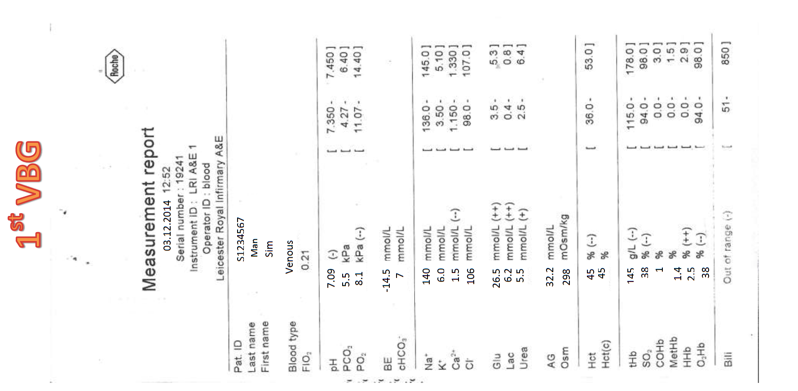

Slide 3
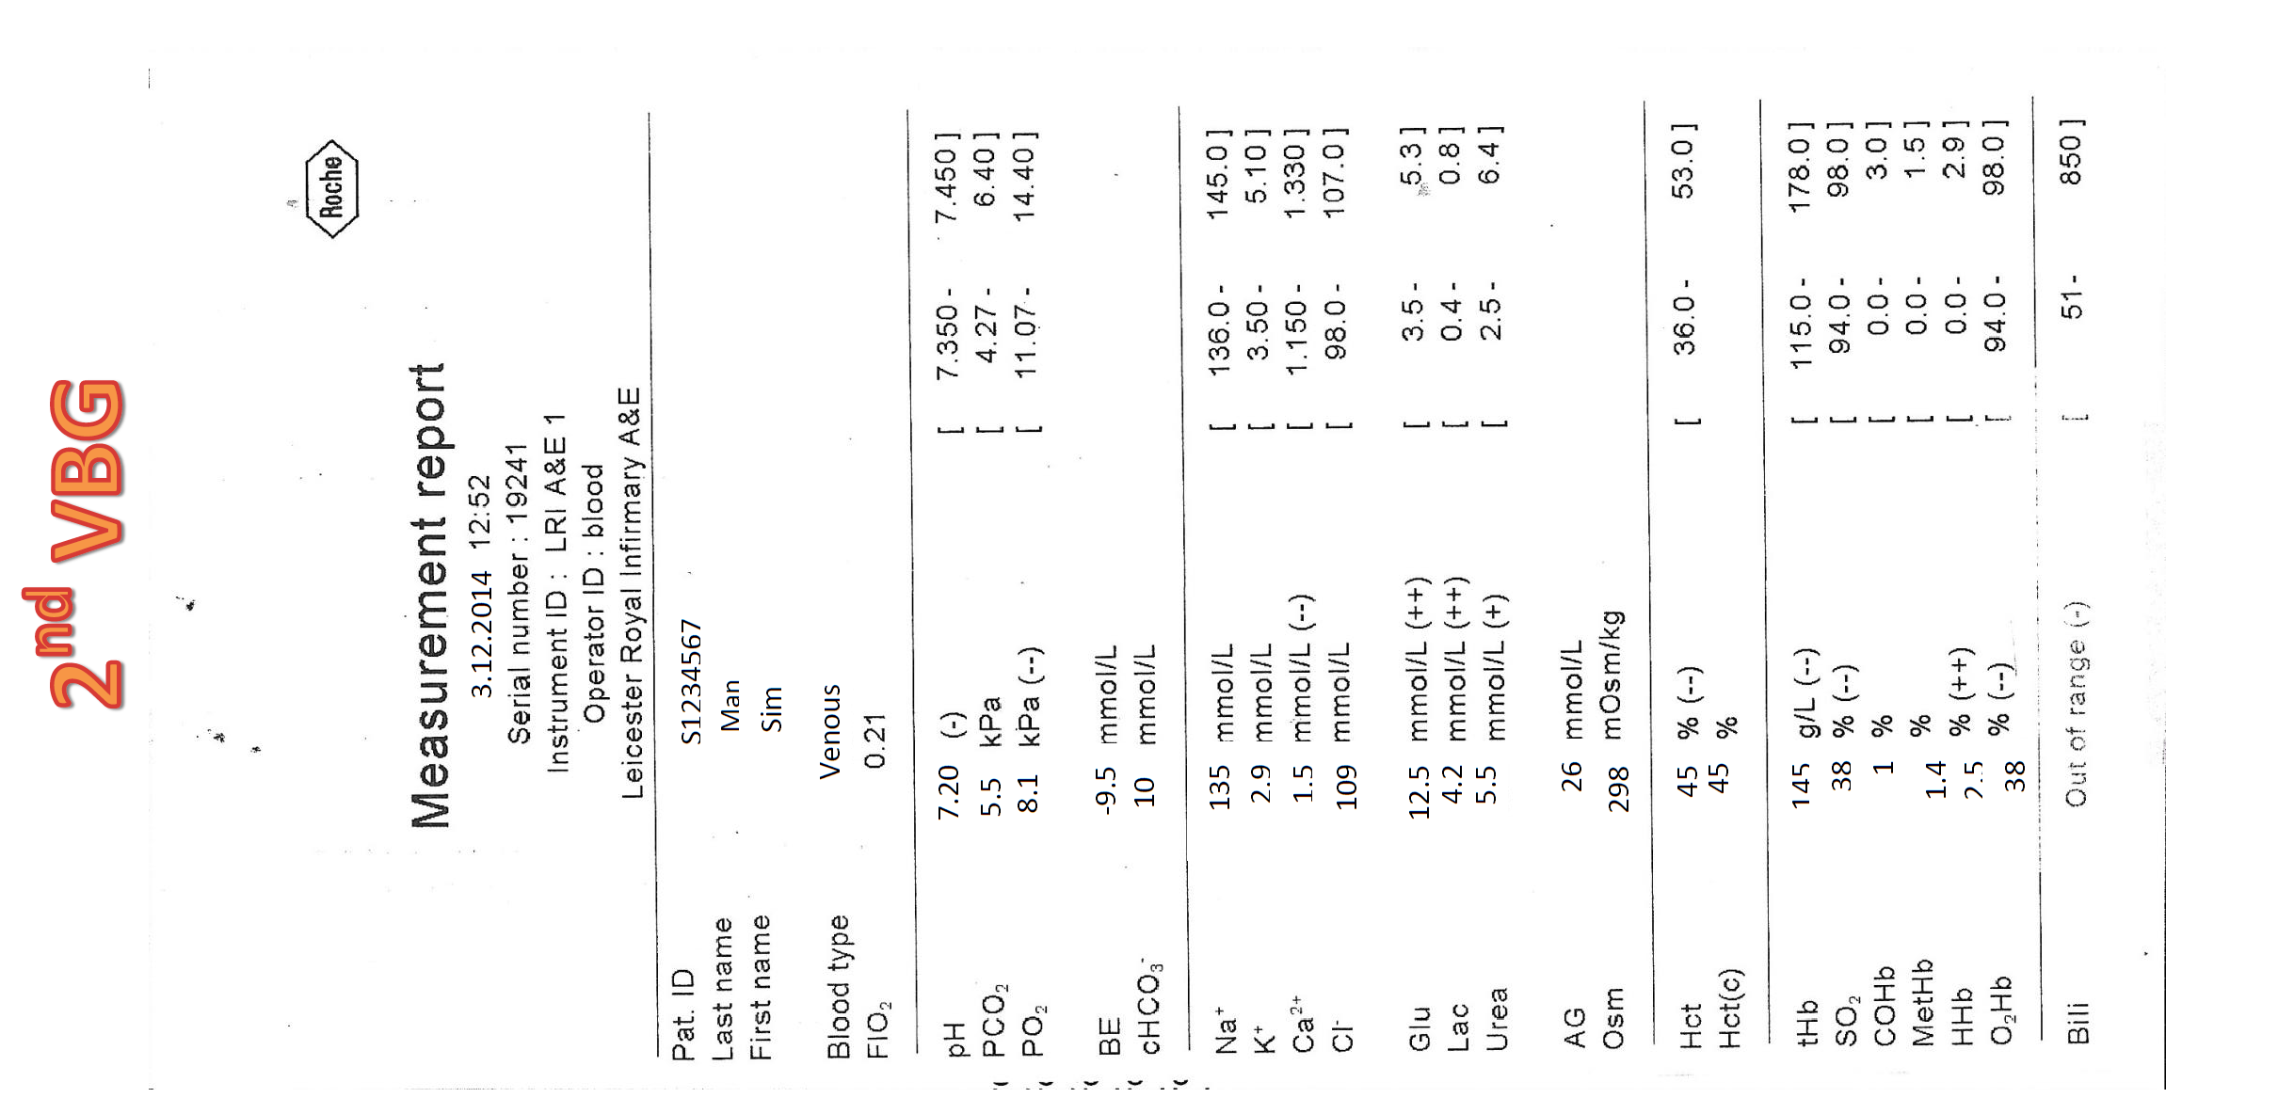

Slide 4
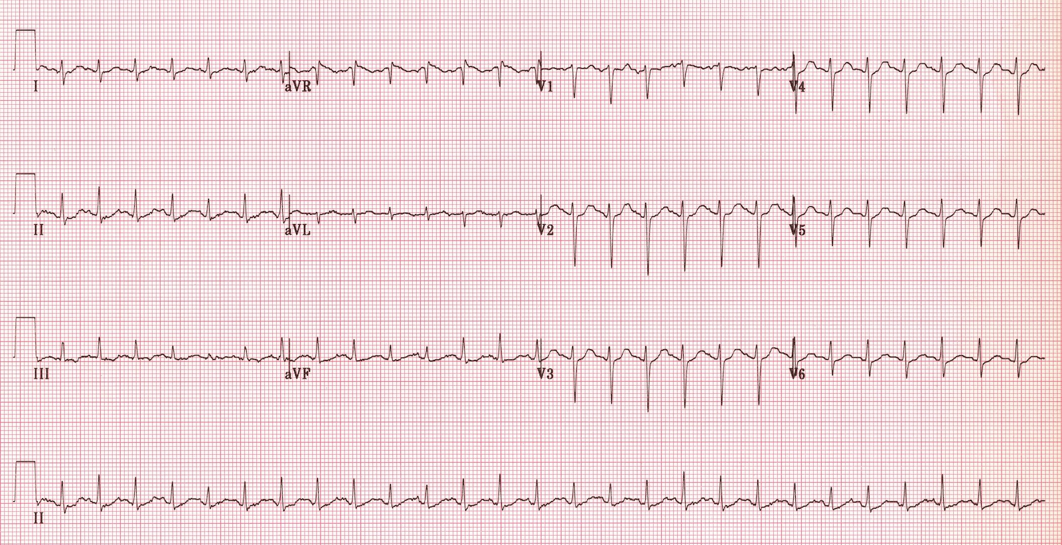
ED Simulator Based Training – Scenario Guide 1

Slide 5



