Slide 1
ED Simulator Based Training –
Set |  | Scenario (Start) |  | Scenario (Progression) |  | Equipment
Adult |  | 25 yr old female is red called to resus after developing difficulty in breathing.Her symptoms started soon after a meal at a local restaurant. There is no PMhx. Swollen lips and eyes,hoarse voice,wheezy chest DHx: None SHx Works at a bank Weekend alcohol use, non-smoker |  | Gradually improves after 2 shots of IM 0.5mg adrenaline. |  | Sim-Man (complete kit) Lifepak defib with training leads Training ‘resus’ equipment trolley
ED Resus Room
Time: (45 mins) Simulation: 30 Debrief: 10 Recover: 5
Main objectives (Clinical and Educational Context): To demonstrate effective, structured A-E primary assessment and recognition of Anaphylaxis Effective and appropriate clinical management of Anaphylaxis Involvement of Anesthetist early Appropriate drawing of correct strength of adrenaline in 1ml syringe9 (i.e 0.5ml of 1:1000) Correct disposition of pt to HDU/ACB
Simulator start state | Position Semi-recumbent on ED trolley in resus bay |  | Physiology A – Able to talk with hoarse voice,mild drooling B - Rate 25, SpO2 91%. C - Pulse 120, BP 90/65. D – E4 V5 M6 pupils equal E – Tpr 35.9 |  | Clinical Findings Hoarse voice,mild drooling B/l chest wheezes
Expected course: Primary survey Identification of anaphylaxis with possible airway compromise Administration of adrenaline repeat adrenaline after 5-10 mins initiation of supportive treatment(nebs, steroids ,anti-histamines) effective post Rx management and referral for specialist (ITU/HDU)
Adapted with permission from Magpas, the Emergency Medical Charity

Slide 2
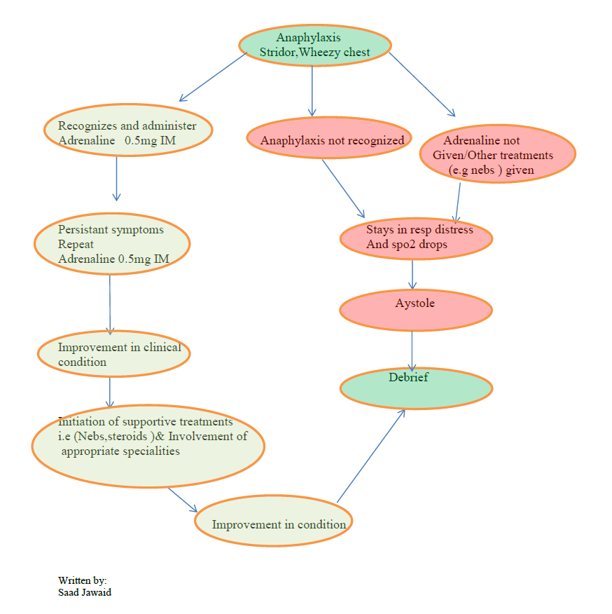
ED Simulator Based Training – Scenario Guide

Slide 3
