Slide 1
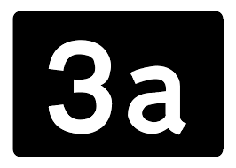
ED Simulator Based Training – SVT
Set |  | Scenario (Start) |  | Scenario (Progression) |  | Equipment
Adult |  | 35yr old female. Self presented to the ED with h/o palpitations for last 2 hours (no chest pain or SOB) PMH None DHx Occasional Marijuana SHx Works at local supermarket. Weekend alcohol use, non-smoker |  | After vagal manoeuvre and adenosine 6mg,12mg,12mg,Pt stays in SVT and is stable hemodynamically. Candidate should look to seek expert advice from cardiologist. Following options are possible. -Considers Atrial flutter as a cause and gives beta blocker to reveal the rhythm -Use Calcium channel blocker for SVT -Uses synchronised cardioversion |  | Sim-Man (complete kit) Lifepak defib with training leads Training ‘resus’ equipment trolley
ED Resus Room
Time: (45 mins) Simulation: 30 Debrief: 10 Recover: 5
Main objectives (Clinical and Educational Context): To demonstrate effective, structured A-E primary assessment and ECG interpretation of Narrow Complex Tachycardia (NCT) - Stable Effective and appropriate clinical management of ‘Stable’ SVT (Administration of Adenosine) Seeks expert advice after adenosine has been unresponsive Safely terminates/treat the rhythm
Simulator start state | Position Semi-recumbent on ED trolley in resus bay |  | Physiology A – Clear & self maintaining. B - Rate 21, SpO2 98%. C - Pulse 150, BP 110/75. No Chest pain D – E4 V5 M6 pupils equal E – Temp 36.9 |  | Clinical Findings Supraventricular tachycardia (SVT) No ‘adverse’ clinical features
Expected course: Primary survey Identification of stable SVT Initiation of Vagal maneuvers followed by adenosine No response to adenosine Seek expert advice

Slide 2
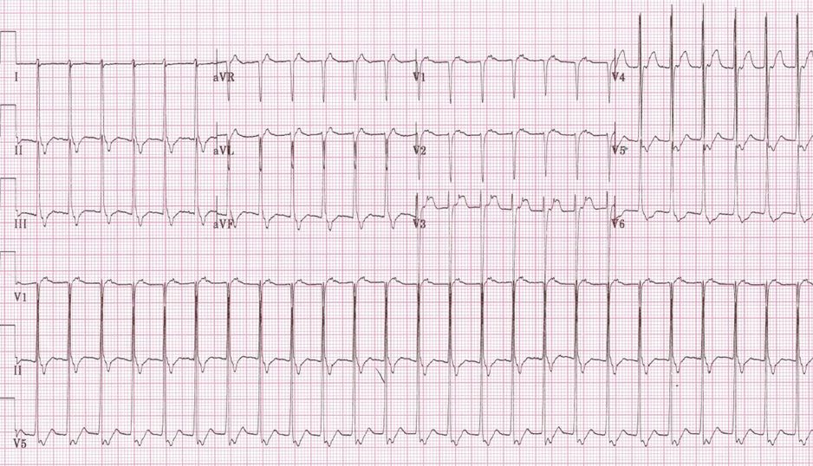

Slide 3
