Slide 1
ED Simulator Based Training – SVT
Set |  | Scenario (Start) |  | Scenario (Progression) |  | Equipment
Adult |  | 35yr old female. Self presented to the ED with h/o palpitations for last 2 hours (no chest pain or SOB) PMH None DHx Occasional Marijuana SHx Works at local supermarket. Weekend alcohol use, non-smoker |  | After vagal manoeuvre and adenosine 6mg,12mg,12mg,Pt stays in SVT and becomes unstable; Becomes dizzy and light headed C/o central chest pain BP 70/40mmHg |  | Sim-Man (complete kit) Lifepak defib with training leads Training ‘resus’ equipment trolley
ED Resus Room
Time: (45 mins) Simulation: 30 Debrief: 10 Recover: 5
Main objectives (Clinical and Educational Context): To demonstrate effective, structured A-E primary assessment and ECG interpretation of Narrow Complex Tachycardia (NCT) - Stable Effective and appropriate clinical management of ‘Stable’ SVT (Administration of Adenosine) Recognition of deterioration in clinical state and initiation of ‘Unstable’ NCT; Sedation, synchronised DC cardioversion
Simulator start state | Position Semi-recumbent on ED trolley in resus bay |  | Physiology A – Clear & self maintaining. B - Rate 21, SpO2 98%. C - Pulse 150, BP 110/75. No Chest pain D – E4 V5 M6 pupils equal E – Temp 36.9 |  | Clinical Findings Supraventricular tachycardia (SVT) Initially no ‘adverse’ clinical features
Expected course: Primary survey Identification of stable SVT Initiation of Vagal maneuvers followed by adenosine recognition of deterioration (stable to unstable features) initiation of safe emergency sedation delivery of safe synchronised cardioversion effective post cardio-version management and referral for specialist cardiology input (GGH)

Slide 2
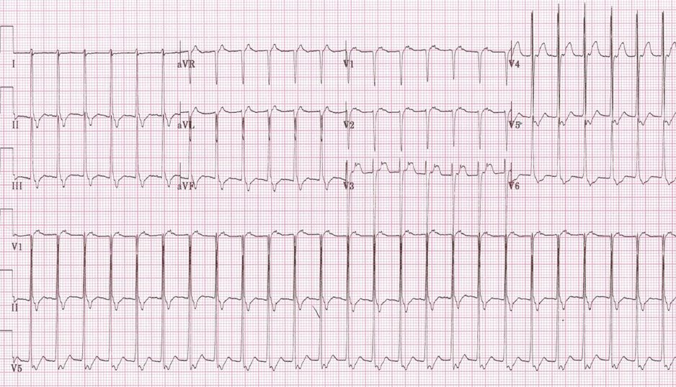

Slide 3
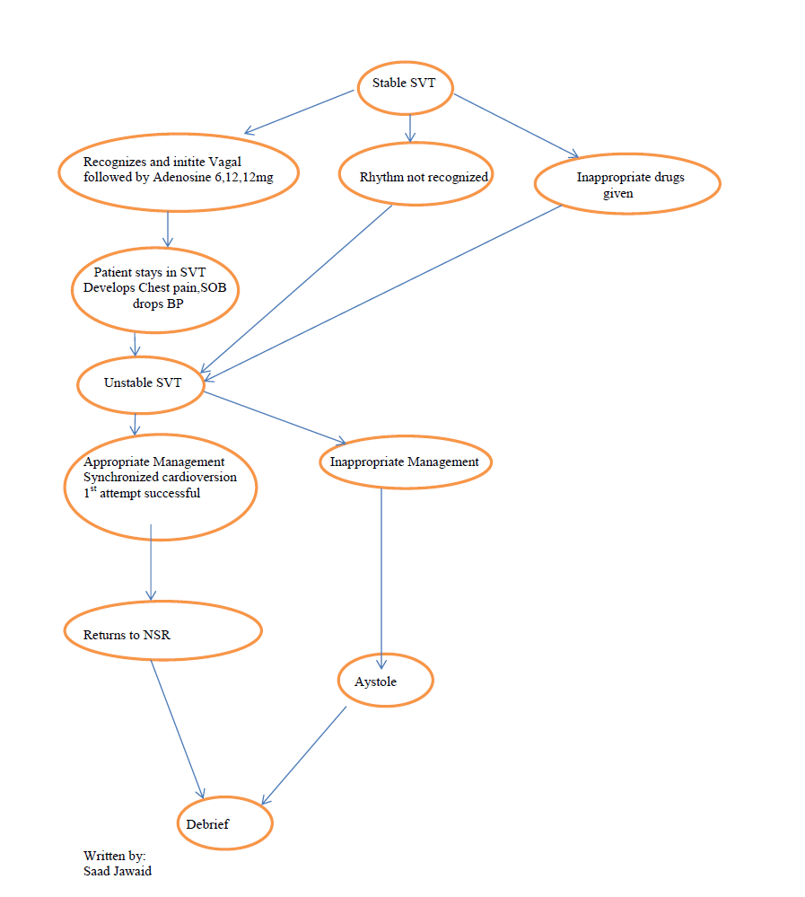

Slide 4
