Slide 1
20
ED Simulator Based Training – Scenario Guide
Set |  | Scenario (Start) |  | Scenario (Progression) |  | Equipment
Adult |  | 86 y/o fall from standing against a chest of draws. On floor for ?24 hrs Pain in chest and leg PMH: Hypertension, Hypothyroid, IHD DHx: Aspirin, Ramipril, Bisoprolol, Thyroxine, Simvastatin SHx Lives alone |  | ABC Recognise chest injury Recognise obs may represent shock Chest Drain CT full trauma series. |  | Sim-Man (complete kit) Lifepak defib with training leads Training ‘resus’ equipment trolley Grey Wig
ED Resus Room
Time: (45 mins) Simulation: 30 Debrief: 10 Recover: 5
Main objectives (Clinical and Educational Context): To demonstrate effective assessment in trauma Recognition of significant injury despite low mechanism Identify need for chest drain and insert appropriate drain Respond to physiology
Simulator start state | Position Alert on ED trolley in resus bay |  | Physiology A – Clear & self maintaining. B - Rate 25, SpO2 87%. (15l) C - Pulse 72, BP 110/75 D – E4 V4 M6 pupils equal E – Tpr 34.9 |  | Clinical Findings Reduced air entry left chest Soft abdomen Painful hip movements Some restriction of neck movement
Expected course: Recognise abnormal physiology → initiate resuscitation → insert chest drain → stabilises → CT

Slide 2
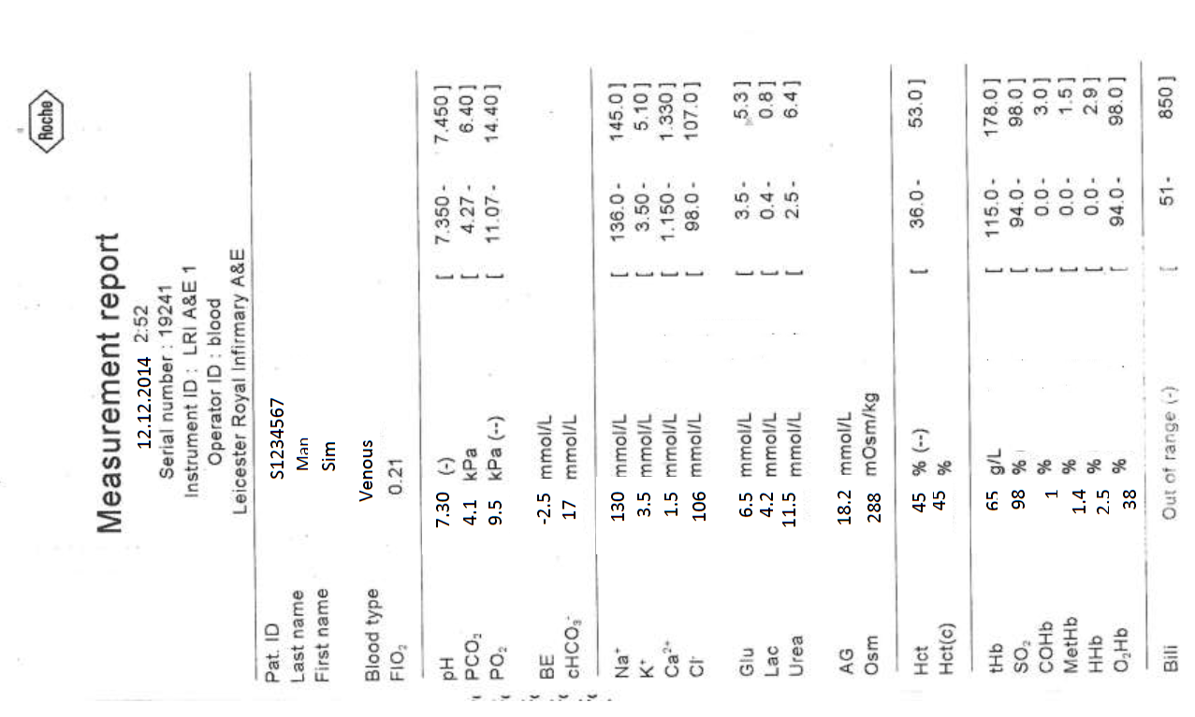
Venous Gas
20

Slide 3
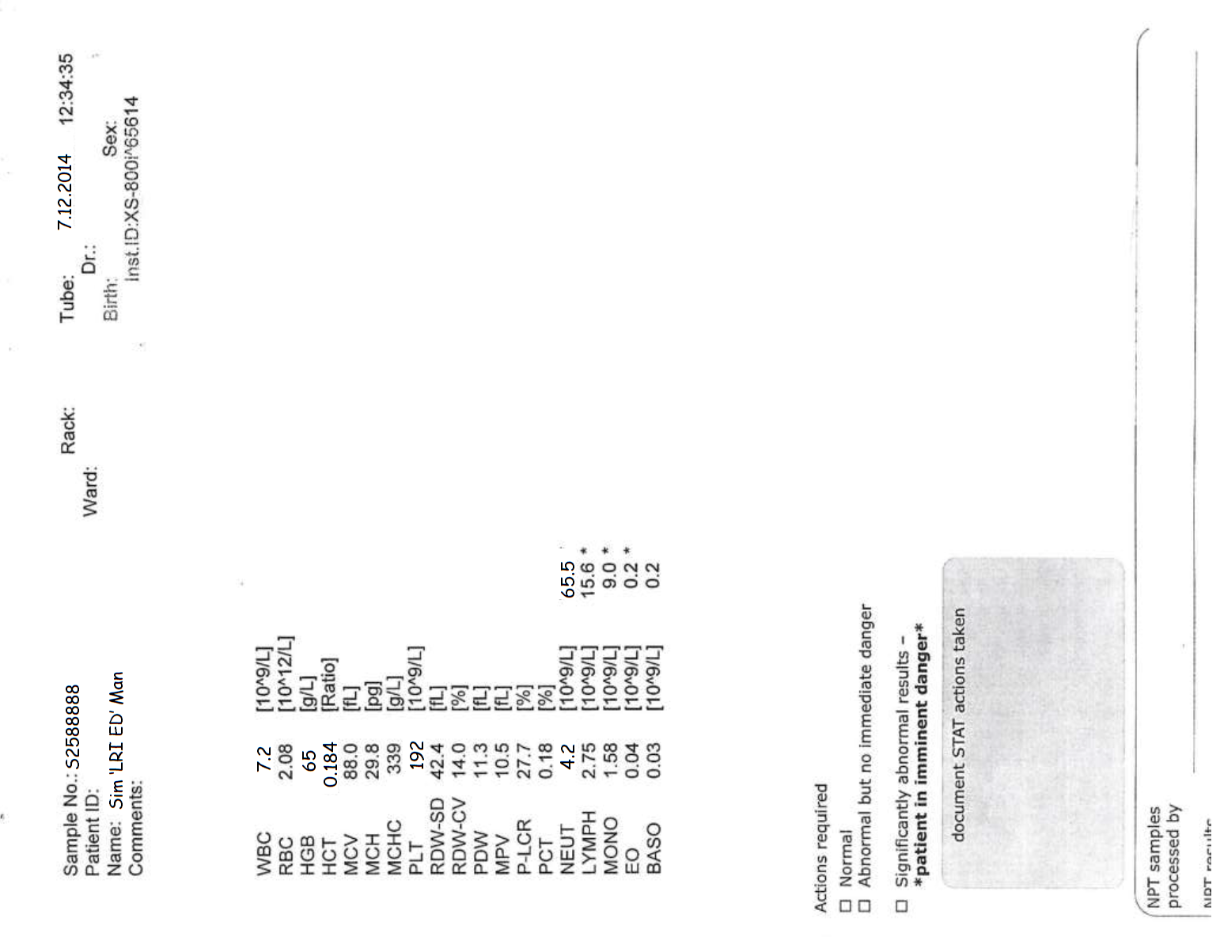
20

Slide 4
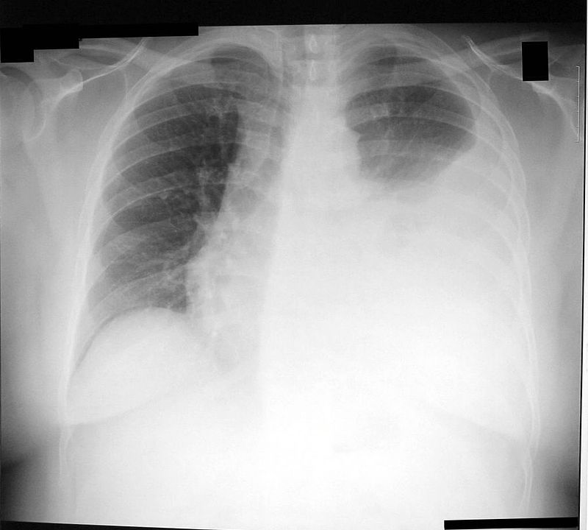
20

