Slide 1
ED Simulator Based Training – Scenario Guide
Set |  | Scenario (Start) |  | Scenario (Progression) |  | Equipment
Adult |  | 69yr old male is brought to Resus by paramedics with the history of SOB for 6 hours progressively getting worse. No chest pain PMH HTN.PCI to LAD 3 yrs. ago DHx Frusemide, Aspirin,Lisinopril,Simvastatin SHx Retired Occasionally drinks alcohol, non-smoker |  | Starts treatment of CHF with Iv frusemide, GTN. After initiation of CPAP, patient becomes stable and should be admitted to GGH CCU Note: If candidate questions or is concerned about LBBB/STEMI, clarify that previous discharge summary suggests old LBBB |  | Sim-Man (complete kit) Lifepak defib with training leads Training ‘resus’ equipment trolley CPAP
ED Resus Room
Time: (45 mins) Simulation: 30 Debrief: 10 Recover: 5
Main objectives (Clinical and Educational Context): To demonstrate effective, structured A-E primary assessment and to make a clinical diagnosis of decompensated CHF Effective and appropriate clinical management of ‘CHF(Oxygen,Frusemide,GTN infusion,CPAP) Appropriate consultation with Cardiology Reg for transfer to GGH
Simulator start state | Position Semi-recumbent on ED trolley in resus bay |  | Physiology A – Clear & self maintaining. B - Rate 35, SpO2 88%. C - Pulse 140, BP 190/95. No Chest pain D – E4 V5 M6 pupils equal E – Tpr 36.9 |  | Clinical Findings Cold, sweaty and in Respiratory distress B/L profuse crepitations on auscultation Raised JVP and pedal edema
Expected course: Primary survey Identification of decompensated CHF(clinical and radiological) Initiation of treatment(Frusdemide,GTN) recognition of hypoxia on O2 and initiation of CPAP Referral to Cardiology and appropriate disposition

Slide 2
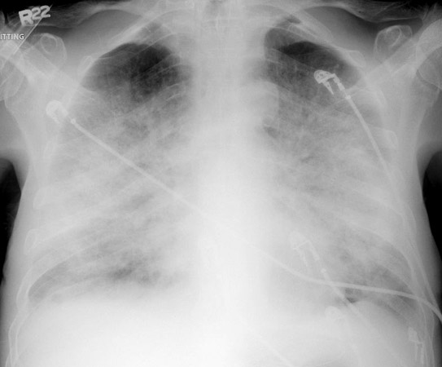

Slide 3
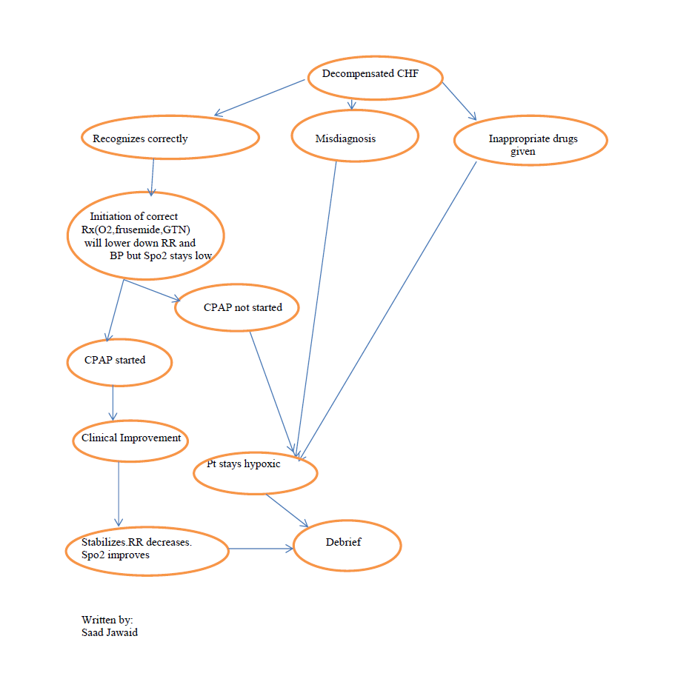

Slide 5
