Slide 1
19
ED Simulator Based Training – Scenario Guide
Set |  | Scenario (Start) |  | Scenario (Progression) |  | Equipment
Adult |  | 21 yr old female self presented via ambulance. History of increasing SOB – tachycardic and tachypnoeic, ?sepsis PMH None DHx OCP SHx Recent holiday/ flight |  | Identify not sepsis, suspect PE – will meet criteria for thrombolysis |  | -Sim-Man (complete kit) -Lifepak defib with training leads -Training ‘resus’ equipment trolley -Resus Cannulation trolley Wig
ED Resus Room
Time: (45 mins) Simulation: 20 Debrief: 10 Recover: 5
 |  |  |  |  |  | Supporting Documents
 |  |  |  |  |  | Nursing assessment sheet Obs chart, ED chart, Drug Chart VBG,FBC,INR,ECG,Urine PT PE thrombolysis guideline
Main objectives (Clinical and Educational Context): To demonstrate effective, structured A-E primary assessment and to make a clinical diagnosis of PE To recognise SEPSIS is not the only diagnosis that makes patients shocked Recognises hemodynamic instability & initiates thrombolysis
Simulator start state | Position Supine on ED trolley in resus bay |  | Observations A – Clear & self maintaining. B - Rate 32, SpO2 92%. C - Pulse 127, BP 79/60. D – GCS 15 pupils equal reactive E – Tpr 37.8 |  | Clinical Findings Bilat air ent – no added sounds Clammy and cool peripheries
Expected course: Primary survey → Identifies PE → Resuscitate/ Thrombolyse → Stabilises

Slide 2
19
ED Simulator Based Training – Scenario Guide 1

Slide 3
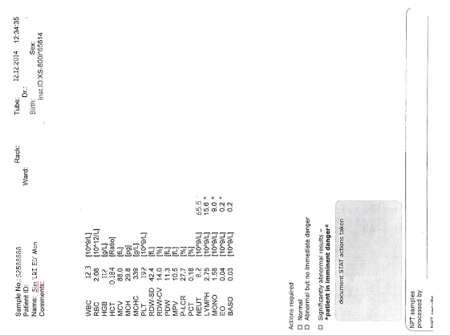
19

