Slide 1
17
ED Simulator Based Training – Scenario Guide 17 Hypoglycaemia
Set |  | Scenario (Start) |  | Scenario (Progression) |  | Equipment
Adult |  | 19yr old Female. Found unresponsive on uni campus by passer by. No evidence of trauma PMH: ? DHx: ? SHx Unknown |  | Recognise Low GCS Identify low BM – Unable to establish IV access Give Glucagon IM Pt stabilises |  | Sim-Man (complete kit) Lifepak defib with training leads Training ‘resus’ equipment trolley ?Medalert necklace - Diabetes
ED Resus Room
Time: (45 mins) Simulation: 30 Debrief: 10 Recover: 5
Main objectives (Clinical and Educational Context): To consider causes of low GCS To examine fully/ expose and identify med alert necklace Recognise hypoglycaemia and commence treatment without IV access Consider alternatives to IV cannula
Simulator start state | Position Unresponsive Supine on ED trolley in resus bay |  | Physiology A – Clear & self maintaining. B - Rate 14, SpO2 98%. C - Pulse 96, BP 120/75 D – E1 V2 M3 pupils equal BM 1.9 E – Tpr 35.9 |  | Clinical Findings Unresponsive Sweaty and clammy Low BM
Expected course: Identify/ Quantify low GCS→ Diagnose Hypoglycamia→ Fail IV access→ Give Glucagon→ BM corrects → Consider further IV/ IO access → Patient Stabalises.

Slide 2
17
Does not give glucagon
Remains Unresponsive
Resp Rate Falls (6)
IO access and Dextrose
Primary Survey & Failed IV access
IV access established
Maintainance Dextrose Commenced and consider causes of Hypo
Gives Glucagon IM
Becomes More Alert

Slide 3
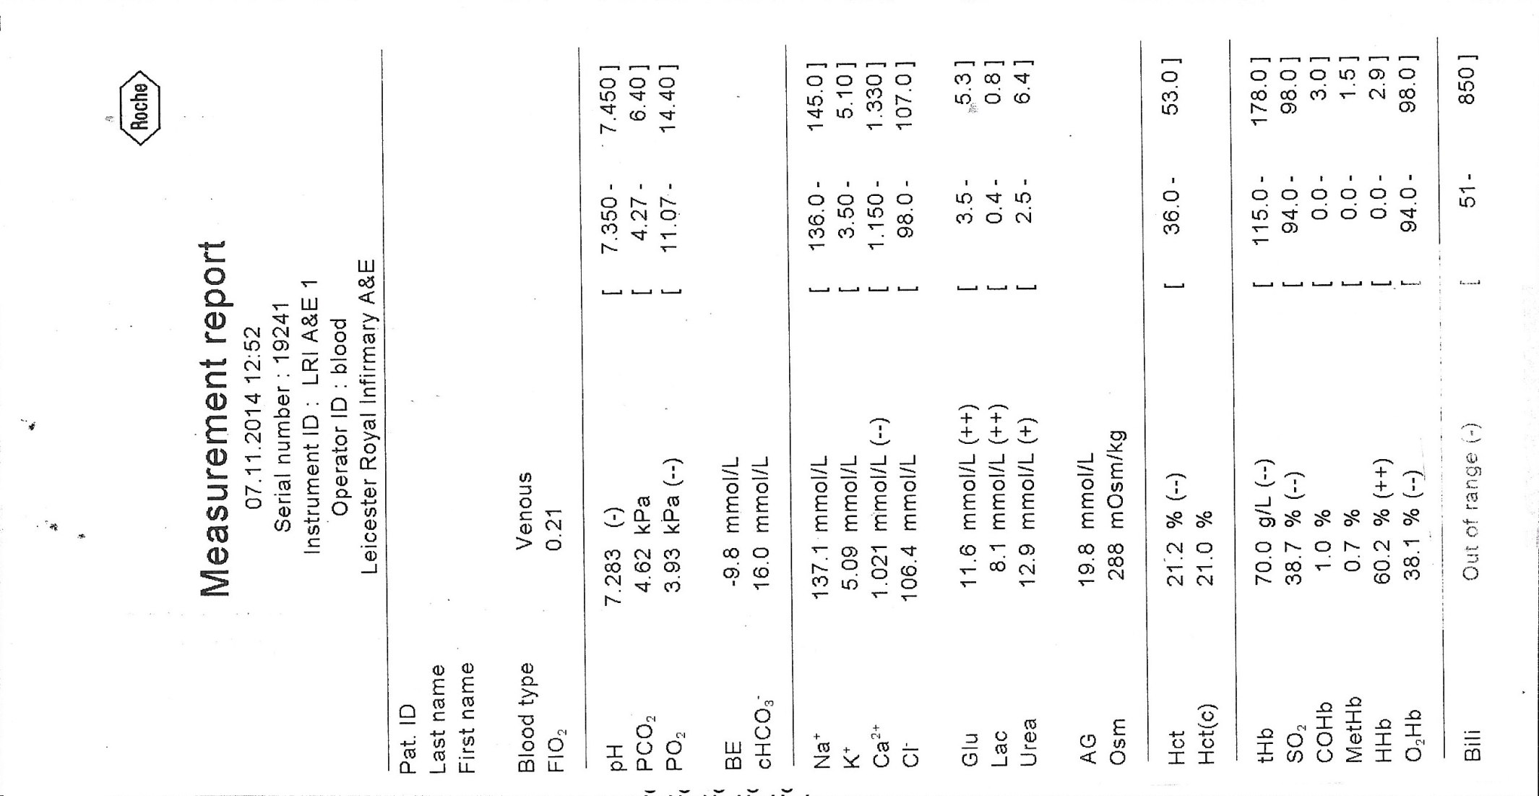
Venous Blood Gas

