Slide 1
ED Simulator Based Training – Scenario Guide
Set |  | Scenario (Start) |  | Scenario (Progression) |  | Equipment
Adult |  | 71 yr old male is brought to Resus by paramedics with the history of difficulty in walking for a day and acute confusion. His wife says he has been fine in the recent past apart from a simple fall he had 2 weeks ago for which he received 2 stitches on forehead in the A&E. PMH Atrial Fibrillation,High cholesterol DHx Warfarin,Simvastatin SHx Lives with wife. Fully independent. |  | See flow chart |  | -Sim-Man (complete kit) -Lifepak defib with training leads -Training ‘resus’ equipment trolley -Resus Cannulation trolley
ED Resus Room
Time: (45 mins) Simulation: 30 Debrief: 10 Recover: 5
 |  |  |  |  |  | Supporting Documents
 |  |  |  |  |  | Nursing assessment sheet Obs chart, ED chart, Drug Chart VBG,FBC,INR,ECG CT head film, PCC pack Beriplex empty ampoules
Main objectives (Clinical and Educational Context): To demonstrate effective, structured A-E primary assessment and to make a clinical diagnosis of Head injury/Intracranial Event Arranges a CT Head as per NICE guidelines and effectively identifies SDH Obtains consultation with Hematology & correctly prescribes PCC. Administers PCC
Simulator start state | Position Supine on ED trolley in resus bay |  | Observations A – Clear & self maintaining. B - Rate 14, SpO2 98%. C - Pulse 80, BP 170/95. D – E3 V4 M5 pupils equal reactive E – Tpr 36.9 |  | Clinical Findings Verbally confused GCS E3 V4 M5 Bruises/steri strips on left forehead
Expected course: Primary survey Identification of injury arranges CT head recognises SDH contacts Haematology Reveres Warfarin using PCC

Slide 2
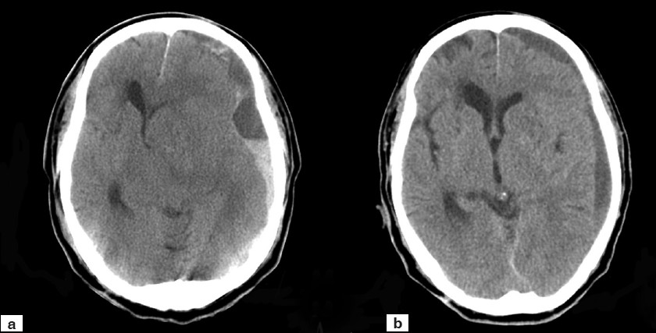

Slide 3
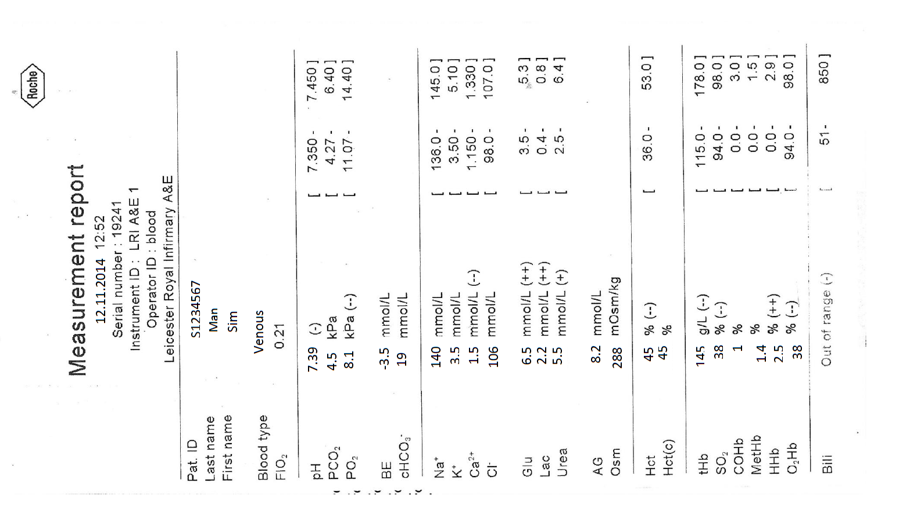
ED Simulator Based Training – Scenario Guide 1

Slide 4
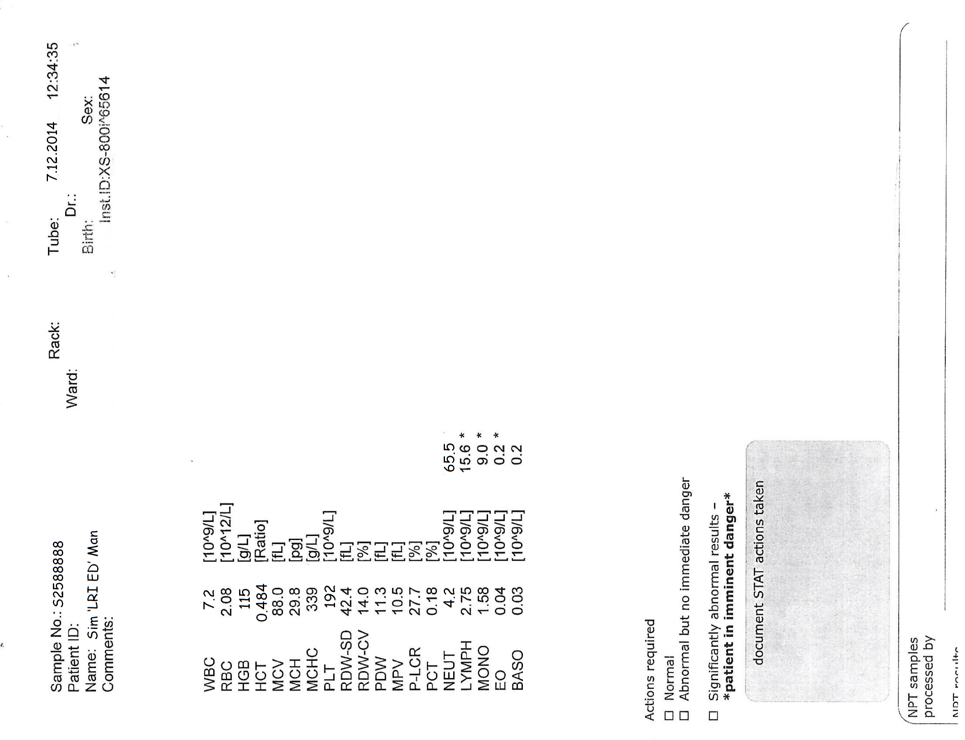

Slide 6
