Slide 1


ED Simulator Based Training – Scenario Guide
Set |  | Scenario (Start) |  | Scenario (Progression) |  | Equipment
Adult |  | 41yr old male is brought to Resus by paramedics with the history of worsening SOB for last 6 hours.He has had flu symptoms for last 2 days. No chest pain, fever or cough is reported. PMH Asthma DHx Blue and brown inhaler SHx Married 2 kids Occasionally drinks alcohol, non-smoker |  | Starts treatment of Severe asthma with back to back Nebs, steroid & MgSo4. Patient doesn’t improve. Pt has features of life threatening asthma. Admission to ITU |  | Sim-Man (complete kit) Lifepak defib with training leads Training ‘resus’ equipment trolley
ED Resus Room
Time: (45 mins) Simulation: 30 Debrief: 10 Recover: 5
Main objectives (Clinical and Educational Context): To demonstrate effective, structured A-E primary assessment and to make a clinical diagnosis of Life threatening Asthma Effective and appropriate clinical management of Asthma (as per NICE guidelines/ED Performa) Appropriate consultation with ITU Reg for transfer to ITU/HDU
Simulator start state | Position Semi-recumbent on ED trolley in resus bay |  | Physiology A – Clear & self maintaining. Unable to complete sentence B - Rate 35, SpO2 88%. Room air C - Pulse 130, BP 110/65. No Chest pain D – E4 V5 M6 pupils equal E – Tpr 36.9 |  | Clinical Findings Cold, sweaty and in Respiratory distress B/L wheeze on auscultation Peak flow unable to perform due to tachypnea
Expected course: Primary survey Identification of features of severe asthma Initiation of treatment(back to back Nebs,Steroids ) recognition of clinical detioration despite treatment and Inc CO2(6.5) on ABG Initiation of IV salbutamol Referral to ITU and appropriate disposition

Slide 2
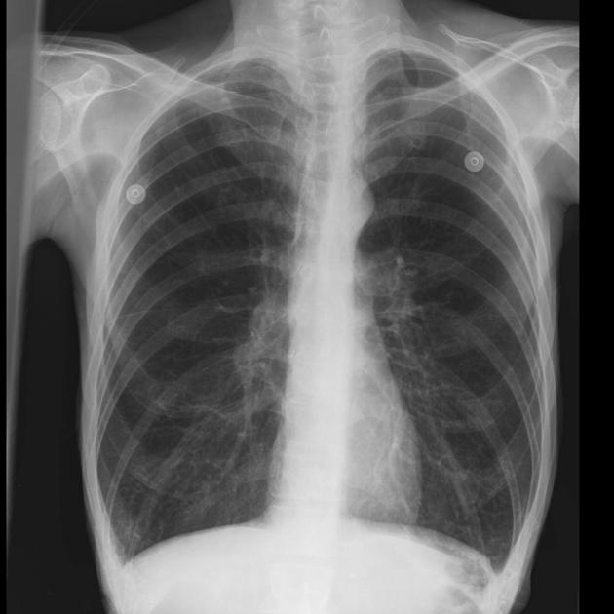
ED Simulator Based Training – Scenario Guide 1

Slide 4
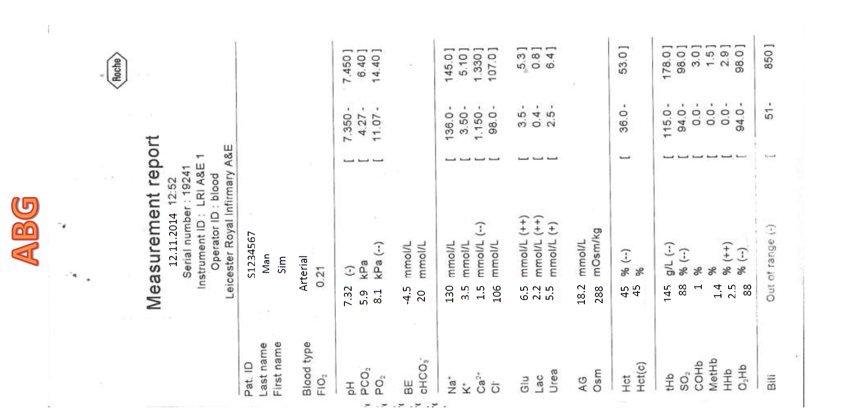
ABG No.1

Slide 5
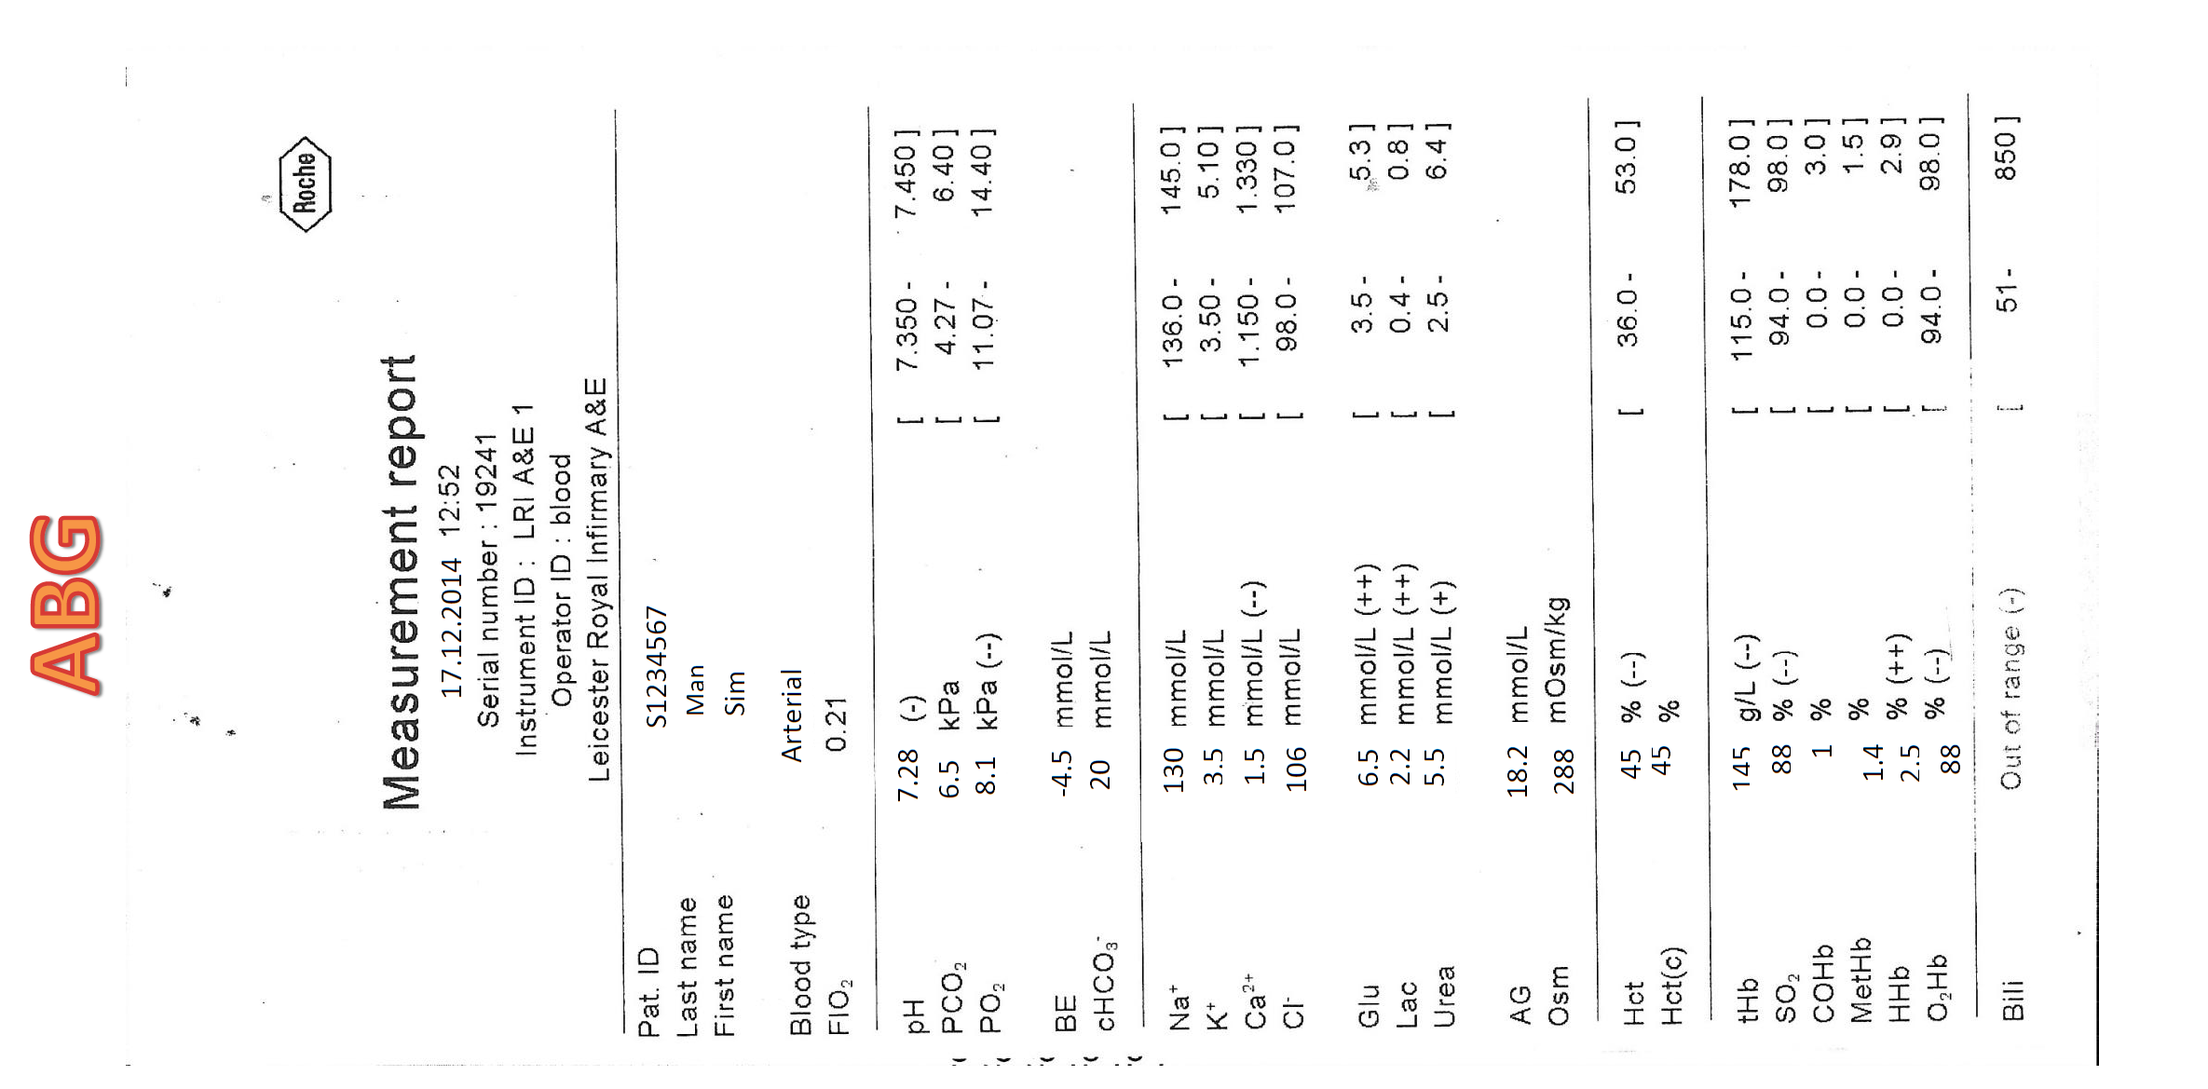
ABG No.2

Slide 6
ED Simulator Based Training – Scenario Guide 1

