Slide 1
ED Simulator Based Training – Scenario Guide
Set |  | Scenario (Start) |  | Scenario (Progression) |  | Equipment
Adult |  | 31yr old male is brought to Resus by paramedics with the history of overdose of unknown substance. Pt was found unresponsive in his room by his room mate. Paramedics found a suicide note.His friends told the EMAS crew that he has long history of mental health and had been having suicidal thought forfew days. PMhx: Depression DHx: Unknown?? SHx: Seperated. Lives in council house |  | Considers this to be high risk suicidal attempt. Previous discharge summary/collateral Hx will reveals patient has been on TCAs. ECG changes will need to be treated according to Tox Base. Considers ITU/ACB referral |  | -Sim-Man (complete kit) -Lifepak defib with training leads -Training ‘resus’ equipment trolley
ED Resus Room
Time: (45 mins) Simulation: 30 Debrief: 10 Recover: 5 |  |  |  |  |  | Supporting Documents
 |  |  |  |  |  | Nursing assessment sheet Obs chart ED chart Drug Chart VBG, ECG
Main objectives (Clinical and Educational Context): To demonstrate effective, structured A-E primary assessment and to make a clinical diagnosis of Significant Self harm Make a diagnosis of TCA(based on ECG,pts past discharge letter) Effective and appropriate clinical management of TCA Appropriate consultation with ITU Reg due to significant ECG
Simulator start state | Position Supine on ED trolley in resus bay |  | Observations A – Clear & self maintaining. B - Rate 24, SpO2 98%. C - Pulse 120, BP 110/95. D – E4 V4 M5 pupils equal,reactive E – Tpr 36.9 |  | Clinical Findings Uncooperative and agitated Intoxicated
Expected course: Primary survey Identification of TCA OD Initiation of MgSO4 and Bicarbonate Correction of metabolic acidosis Referral to ITU and appropriate disposition

Slide 2
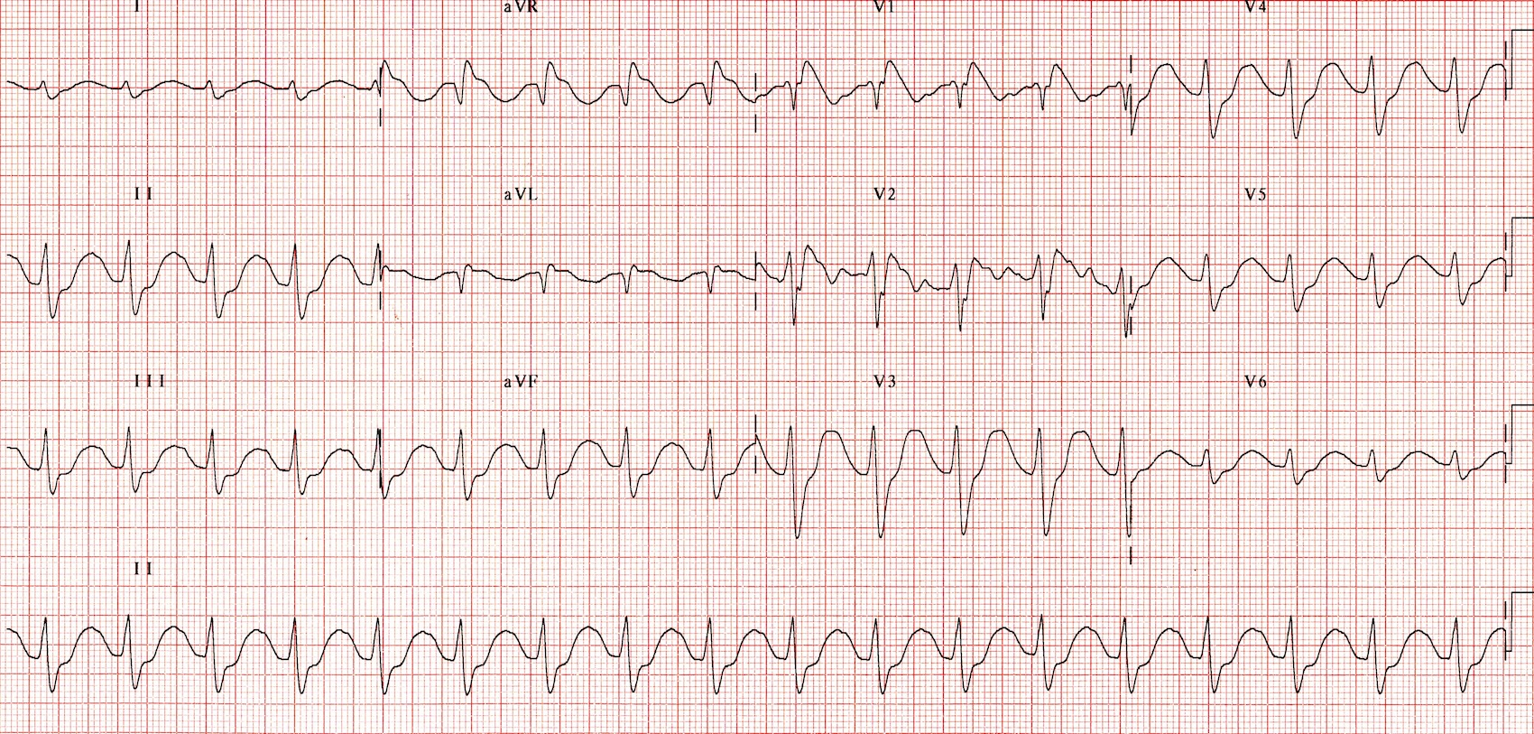

Slide 3
