Slide 1
ED Simulator Based Training – Scenario Guide
Set |  | Scenario (Start) |  | Scenario (Progression) |  | Equipment
Adult |  | 31yr old female is brought to Resus by paramedics after she was found unresponsive in her room by her friends. Paramedics found few empty packets of paracetamol and few other unknown pills on the bed but couldn’t find the boxes. Smells strongly of alcohol. PMH : Depression DHx : Unknown??? SHx :Seperated. Lives in council house |  | Starts treatment of Paracetamol OD by prescribing NAC. All 4 bags should be prescribed.Pt vomits.May aspirate if not rolled over.Not a suitable patient for EDU due to low GCS and unknown mixed overdose. If time allows, patient will develop anaphylaxis to NAC. |  | -Sim-Man (complete kit) -Lifepak defib with training leads -Training ‘resus’ equipment trolley
ED Resus Room
Time: (45 mins) Simulation: 30 Debrief: 10 Recover: 5
 |  |  |  |  |  | Supporting Documents
 |  |  |  |  |  | Paracetamol Pathway Nursing assessment sheet Obs,ED & Drug Chart VBG ECG
Main objectives (Clinical and Educational Context): To demonstrate effective, structured A-E primary assessment and to make a clinical diagnosis of Mixed OD (Paracetamol+unknown i.e codiene PO4) Effective and appropriate clinical management of Paracetamol OD i.e start NAC as amount and time are uncertain Appriopriately manages the NAC reaction Look for collateral history Appropriate disposition to specialty
Simulator start state | Position Supine on ED trolley in resus bay |  | Observations A – Clear & self maintaining. B - Rate 14, SpO2 98%. C - Pulse 100, BP 110/95. D – E4 V4 M5 pupils equal ,pin point E – Tpr 36.9 |  | Clinical Findings Strong smell of alcohol Uncooperative and agitated
Expected course: Primary survey Identification of mixed OD Initiation of NAC recognition of drop in GCS due to mixed OD prevent aspiration when patient vomits Referral to ITU and appropriate disposition

Slide 2
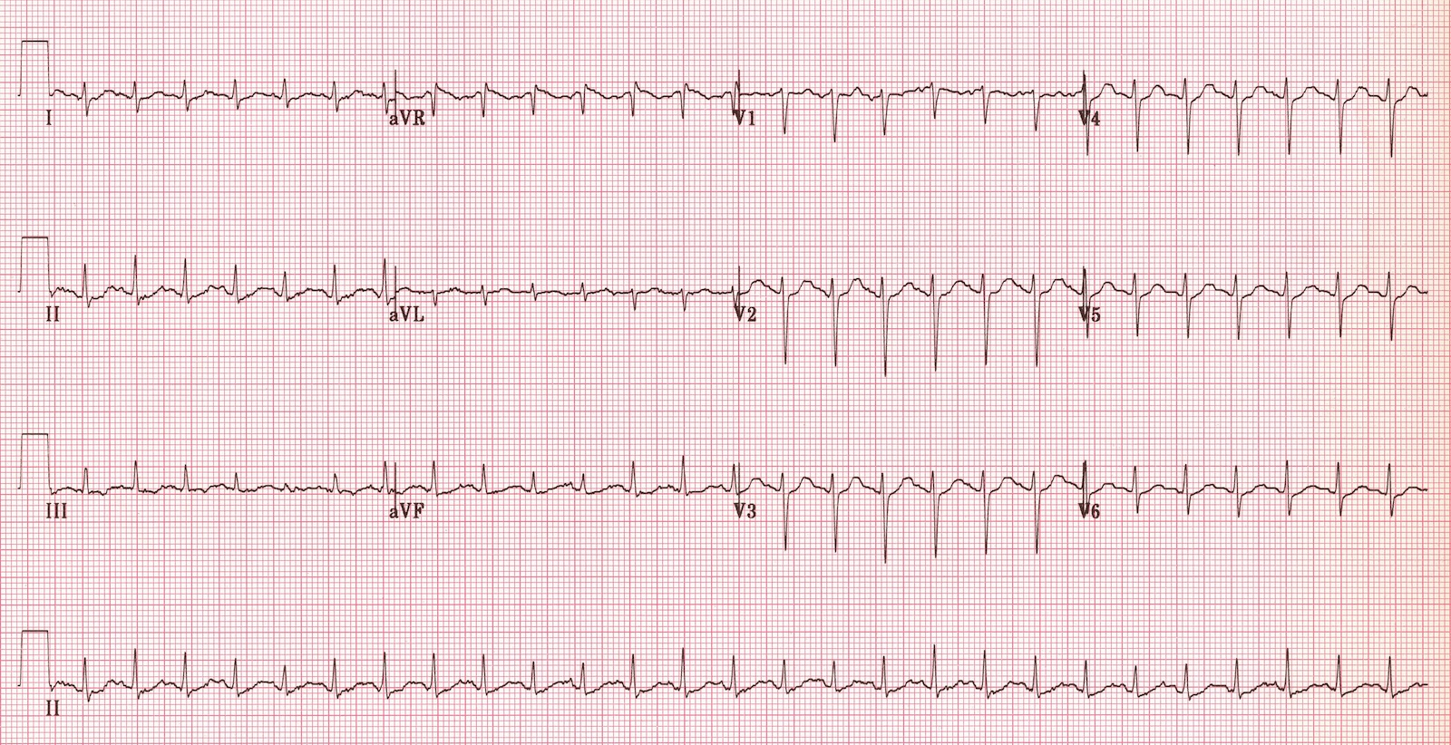

Slide 3
Lab result
Patient name: Sarah hayne
S no.1234566
Paracetamol level: 240mmol/L
Results taken by :Dr EM3 Reg

Slide 4
