Slide 1
ED Simulator Based Training – Scenario Guide 1
Set |  | Scenario (Start) |  | Scenario (Progression) |  | Equipment
Adult |  | 65yr old male. Self presented to the ED with h/o palpitations for last 2 hours (no chest pain or SOB) PMH HTN IHD (previous MI – Stented) DHx Ramipril, Simvastatin, Bisoprolol, Aspirin SHx Retired, lives with wife and one daughter. Weekend alcohol use, non-smoker |  | During administration of amiodarone infusion; Becomes dizzy and light headed C/o central chest pain BP 70/40mmHg |  | Sim-Man (complete kit) Lifepak defib with training leads Training ‘resus’ equipment trolley
ED Resus Room
Time: (45 mins) Simulation: 30 Debrief: 10 Recover: 5
Main objectives (Clinical and Educational Context): To demonstrate effective, structured A-E primary assessment and ECG interpretation of Broad Complex Tachycardia (BCT) - Stable Effective and appropriate clinical management of ‘Stable’ BCT (Administration of Amiodarone) Recognition of deterioration in clinical state and initiation of ‘Unstable’ BCT; synchronised DC cardioversion Involvement of Anaesthetist or ED consultant for sedation Initiation of appropriate post arrest management and referral to specialty team (GGH cardiology)
Simulator start state | Position Semi-recumbent on ED trolley in resus bay |  | Physiology A – Clear & self maintaining. B - Rate 15, SpO2 98%. C - Pulse 200, BP 110/75. No Chest pain D – E4 V5 M6 pupils equal E – Tpr 35.9 |  | Clinical Findings Broad complex tachycardia (VT) Initially no ‘adverse’ clinical features
Expected course: Primary survey Identification of stable VT Initiation of appropriate anti-arrhythmic recognition of deterioration (stable to unstable features) initiation of safe emergency sedation delivery of safe synchronised cardioversion referral for specialist cardiology input (GGH)

Slide 2
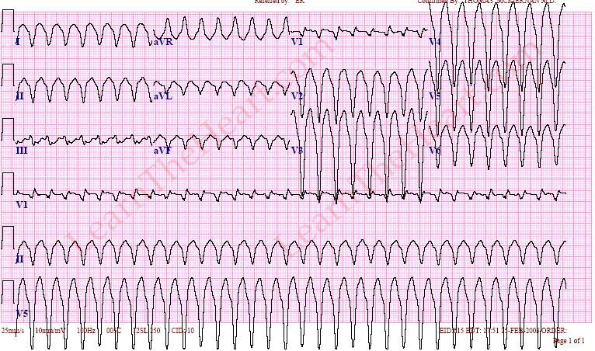

Slide 3
